Slide 1
LATTICE QCD AT NON-ZERO BARYON DENSITY
Attila Pásztor
ELTE Eötvös Loránd University, Budapest
(Wuppertal-Budapest collaboration)
Stavanger, Norway, 2024.04.09.

Slide 2
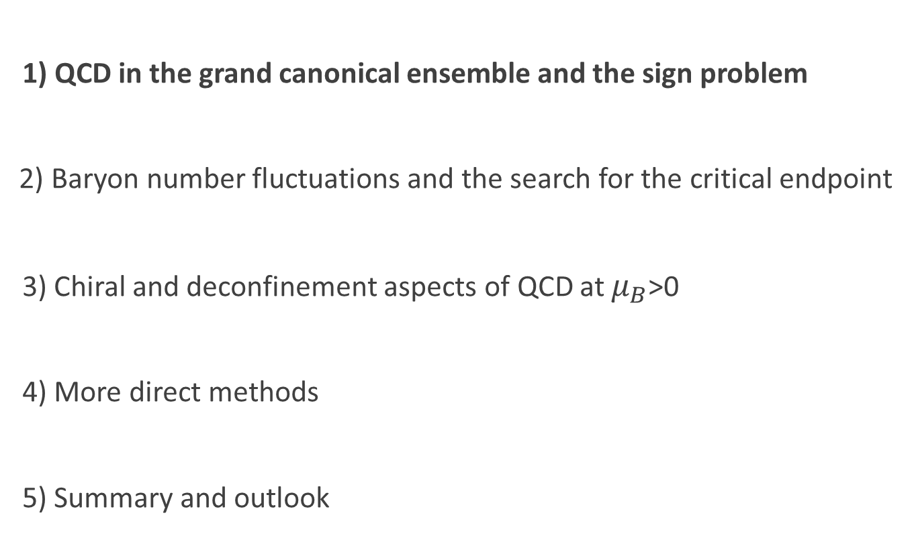
Outline
1) QCD in the grand canonical ensemble and the sign problem
2) Baryon number fluctuations and the search for the critical endpoint
3) Chiral and deconfinement aspects of QCD at $μ_{B}$>0
4) More direct methods
5) Summary and outlook

Slide 3
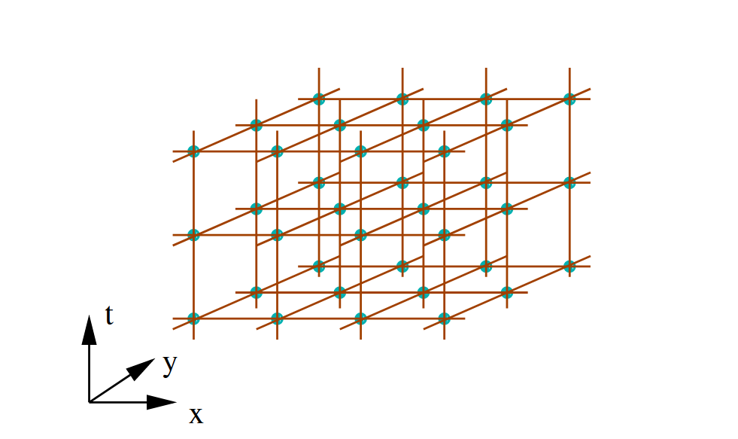
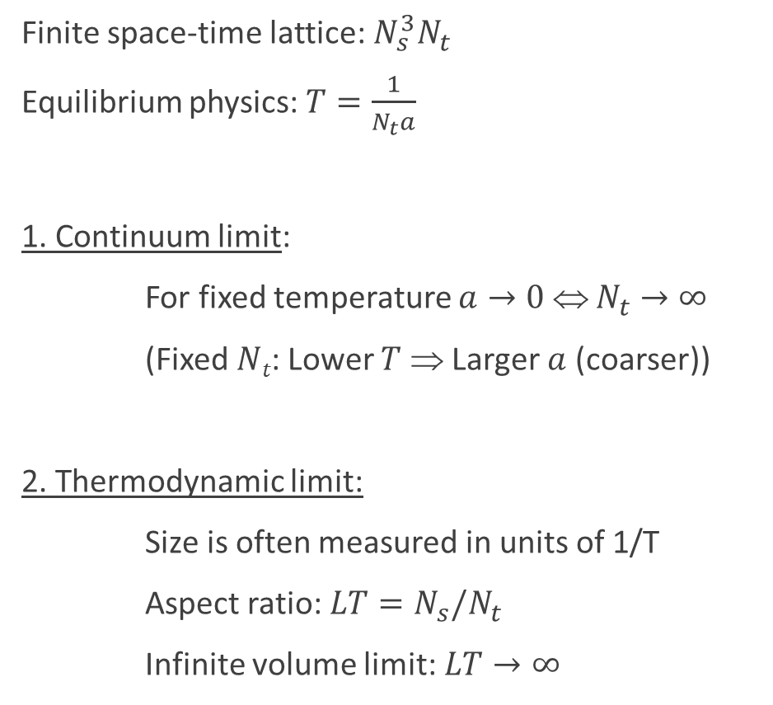
The lattice formulation of QCD
Finite space-time lattice: $N_{s}^{3}N_{t}$
Equilibrium physics: $T=\frac{1}{N_{t}a}$
1. Continuum limit:
For fixed temperature $a→0$ ⇔ $N_{t}→∞$
(Fixed $Nt$: Lower $T$ ⇒ Larger $a$ (coarser))
2. Thermodynamic limit:
Size is often measured in units of 1/T
Aspect ratio: $LT=N_{s}/N_{t}$
Infinite volume limit:$LT→∞$
QCD in a small box is physics, a coarse lattice in a large box is not!

Slide 4
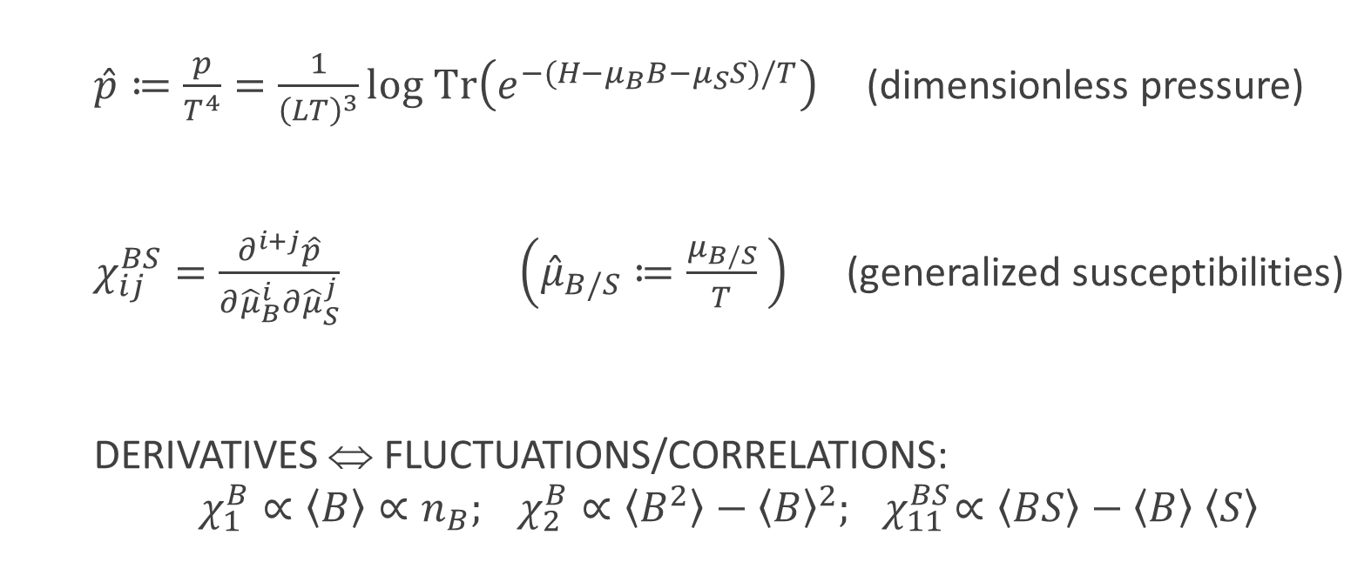
QCD in the grand canonical ensemble
          $\hat{p}≔\frac{p}{T^{4}}=\frac{1}{{\left(LT\right)}^{3}}log Tr\left(e^{−(H−μ_{B}B−μ_{S}S)/T}\right)$ (dimensionless pressure)
          $χ_{ij}^{BS}=\frac{∂^{i+j}\hat{p}}{∂{\hat{μ}}_{B}^{i}∂{\hat{μ}}_{S}^{j}} \left({\hat{μ}}_{B/S}≔\frac{μ_{B/S}}{T} \right)$ (generalized susceptibilities)
          DERIVATIVES ⇔ FLUCTUATIONS/CORRELATIONS:
          $χ_{1}^{B}∝\left\langle B\right\rangle ∝n_{B}; χ_{2}^{B}∝\left\langle B^{2}\right\rangle −{\left\langle B\right\rangle }^{2}; { χ}_{11}^{BS}∝\left\langle BS\right\rangle −\left\langle B\right\rangle$ $\left\langle S\right\rangle$

Slide 5




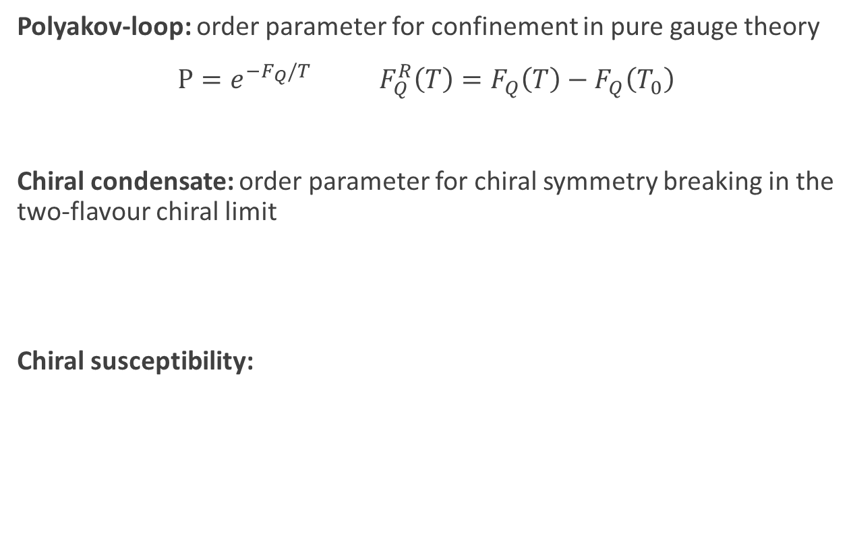
Other observables
Polyakov-loop: order parameter for confinement in pure gauge theory
$P=e^{−F_{Q}/T} F_{Q}^{R}\left(T\right)=F_{Q}\left(T\right)−F_{Q}\left(T_{0}\right)$
Chiral condensate: order parameter for chiral symmetry breaking in the
two-flavour chiral limit
Chiral susceptibility:

Slide 6
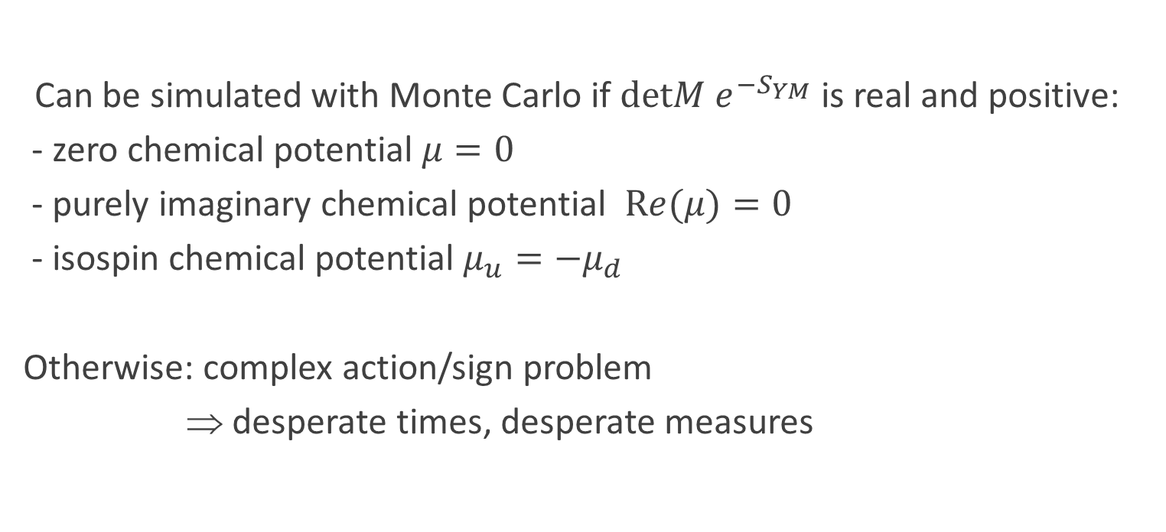
The QCD path integral
$$Z=∫DA_{μ}D\overline{ψ}Dψe^{−S_{YM}−\overline{ψ}M(A_{μ},m,μ)ψ}=∫DA_{μ}detM(A_{μ},m,μ) e^{−S_{YM}}$$
Can be simulated with Monte Carlo if $detM e^{−S_{YM}}$ is real and positive:
- zero chemical potential $μ=0$
- purely imaginary chemical potential $Re(μ)=0$
- isospin chemical potential $μ_{u}=−μ_{d}$
Otherwise: complex action/sign problem
⇒ desperate times, desperate measures

Slide 7

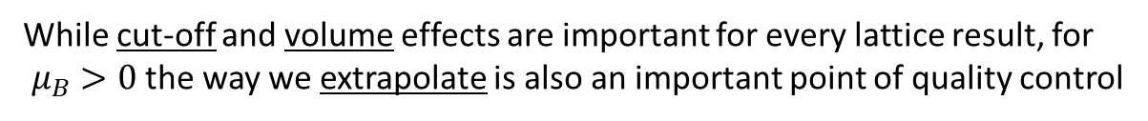
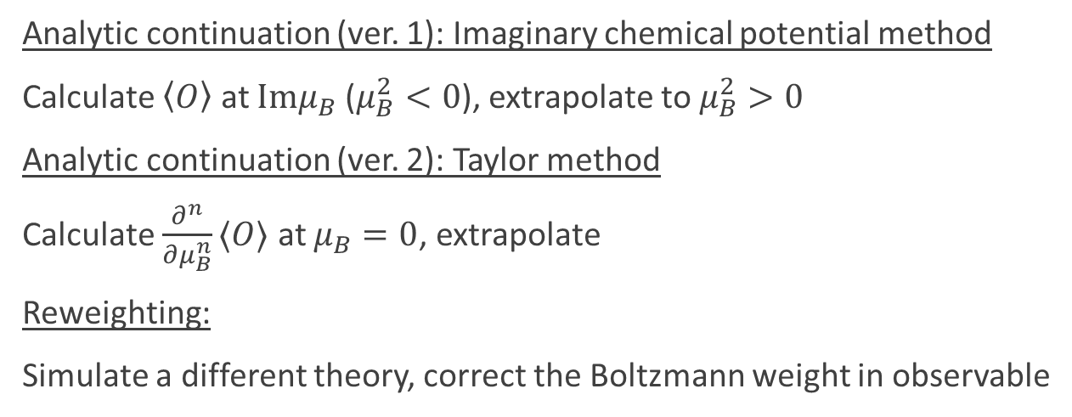
Lattice QCD at nonzero baryon density
Analytic continuation (ver. 1): Imaginary chemical potential method
Calculate $\left\langle O\right\rangle$ at ${Imμ}_{B}$ ($μ_{B}^{2}<0$), extrapolate to $μ_{B}^{2}>0$
Analytic continuation (ver. 2): Taylor method
Calculate $\frac{∂^{n}}{∂μ_{B}^{n}}⟨O⟩$ at $μ_{B}=0$, extrapolate
Reweighting:
Simulate a different theory, correct the Boltzmann weight in observable
COS
T
While cut-off and volume effects are important for every lattice result, for
$μ_{B}>0$ the way we extrapolate is also an important point of quality control

Slide 8
Outline
1) QCD in the grand canonical ensemble and the sign problem
2) Baryon number fluctuations and the search for the critical endpoint
3) Chiral and deconfinement aspects of QCD at $μ_{B}$>0
4) More direct methods
5) Summary and outlook

Slide 9
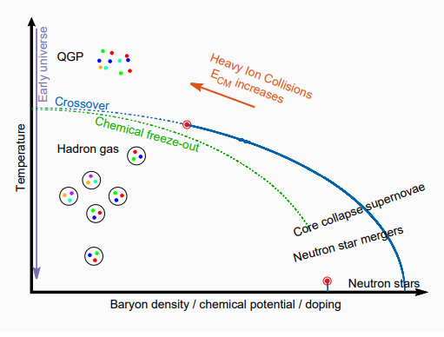
The conjectured phase diagram

Slide 10
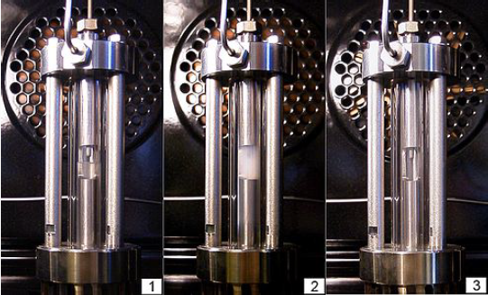

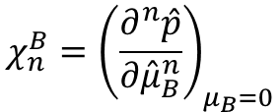


Critical fluctuations
Experiment: tune to criticality
Lattice/Taylor: try to see it from far away
$$χ_{n}^{B}={\left(\frac{∂^{n}\hat{p}}{∂{\hat{μ}}_{B}^{n}}\right)}_{μ_{B}=0}$$
To as large n as possible…
To hopefully see a divergence…
2nd order known since 2012
4th order known since 2015
6th order only now (2024) getting clean
8th maybe…
$$T<T_{c}$$
$$T≈T_{c}$$
$$T>T_{c}$$
HEAT THE SYSTEM
Picture from Wikipedia

Slide 11
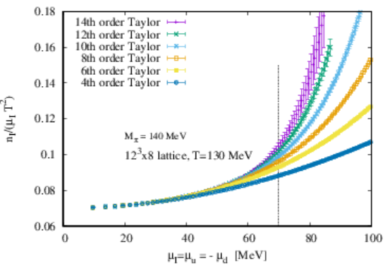
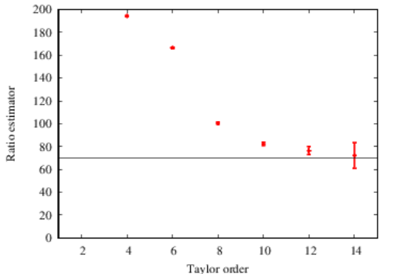
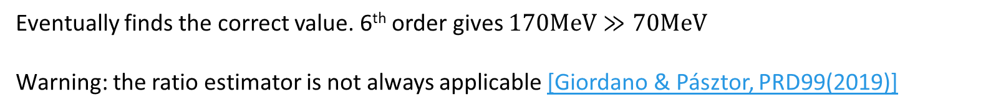

Is this even possible?
A case study: pion condensation [Wuppertal-Budapest, PRD109 (2024)]
Instead of $μ_{B}$, introduce $μ_{I}$ (prefers $π^{+}$ over $π^{−}$)
Second order transition at low $T$ and $μ_{I}≈m_{π}/2≈70MeV$[Son, Stephanov, PRL (2001)]
Eventually finds the correct value. 6th order gives $170MeV≫70MeV$
Warning: the ratio estimator is not always applicable [Giordano & Pásztor, PRD99(2019)]

Slide 12
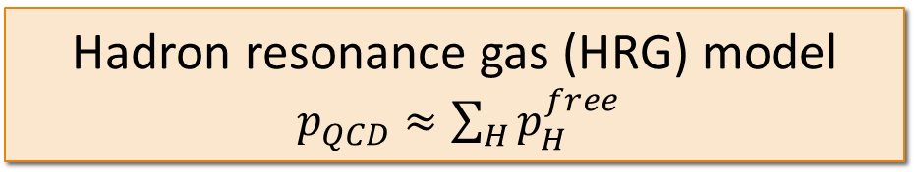
The HRG as a non-critical baseline
Let us start in a humble way, by comparing with a non-critical model.
Hadron resonance gas (HRG) model
$p_{QCD}≈\sum_{H}{p_{H}^{free}}$
sum over stable hadrons and resonances
heavy ion phenomenology uses the HRG as a non-critical baseline
(non-trivial: see, e.g., [Braun-Munzinger et al, NPA1008(2021)])
in lattice QCD: can use grand canonical ensemble
minimum goal: establish deviations from HRG (with good quality control!)
WHAT ARE THE CORRECTIONS TO THE HRG? ARE THEY LARGE?

Slide 13
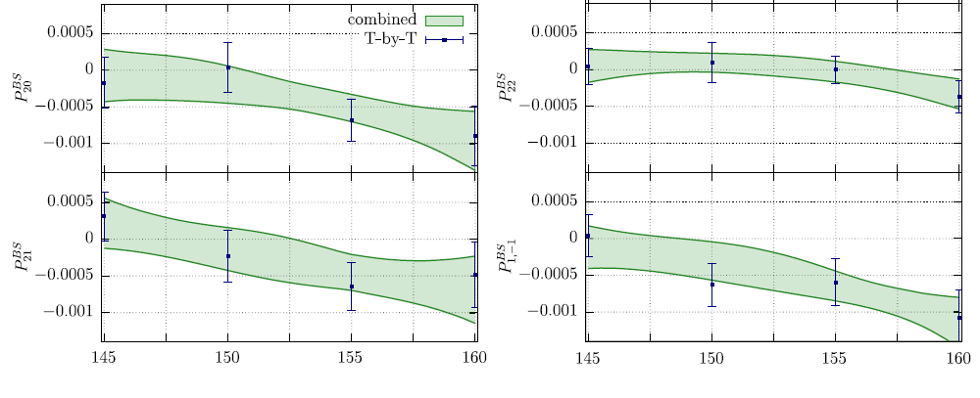










Corrections to the HRG (fugacity expansion)
$\hat{p}\left(T,μ_{B},μ_{S}\right) =P_{00}^{BS}\left(T\right)+…+P_{10}^{BS}\left(T\right)cosh⁡({\hat{μ}}_{B})+P_{11}^{BS}\left(T\right)\cosh\left({\hat{μ}}_{B}{−\hat{μ}}_{S}\right)+…+P_{20}^{BS} (T) \cosh\left({2\hat{μ}}_{B}\right)+…$
$χ_{1}^{B}\left(T,μ_{B},μ_{S}\right)= P_{10}^{BS}\left(T\right)sinh⁡({\hat{μ}}_{B})+P_{11}^{BS}\left(T\right)\sinh\left({\hat{μ}}_{B}{−\hat{μ}}_{S}\right)+…+{2P}_{20}^{BS} (T) \sinh\left({2\hat{μ}}_{B}\right)+…$
$χ_{2}^{B}\left(T,μ_{B},μ_{S}\right)= P_{10}^{BS}\left(T\right)\cosh\left({\hat{μ}}_{B}\right)+P_{11}^{BS}\left(T\right)cosh\left({\hat{μ}}_{B}{−\hat{μ}}_{S}\right)+…+{4P}_{20}^{BS} \left(T\right)cosh\left({2\hat{μ}}_{B}\right)+…$
$$π$$
$$N$$
$$Λ$$
$$N−N$$
Higher order ⇒ larger beyond HRG corr.
S-matrix formalism
[Dashen et al, PR187 (1969)]
Repulsive ⇒ - partial pressure
Attractive ⇒ + partial pressure
B=2,3 etc. are exp. suppressed at low T
$$N−N$$
$$Λ−Λ$$
$$N−Ξ$$
$$N−Λ$$
p$−K_{0}$
[Wuppertal-Budapest, PRD104(2021)]
Scale of short-range repulsive interations is between 1-3.5 fm³
Attila Pásztor

Slide 14
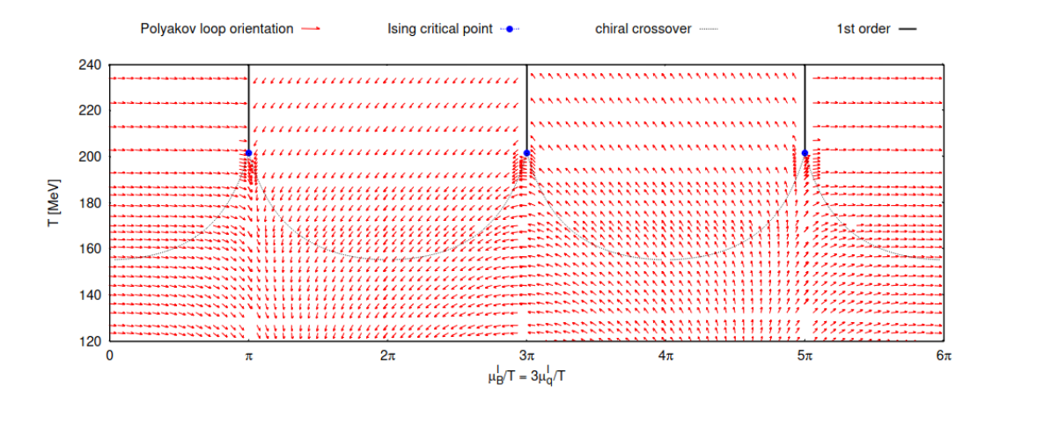

Imaginary chemical potential
Roberge-Weiss periodicity:
$$Z\left(\frac{μ_{q}}{T}\right)=Z(\frac{μ_{q}}{T}+i\frac{2π}{3})$$
From $Z=Tr\left(e^{−(H−μ_{q}{(N}_{u}+N_{d}+N_{s}))/T}\right)$ one would naively expect a $2π$ periodicity, not $\frac{2π}{3}$
RW periodicity → in the fugacity expansion, only terms with integer B appear

Slide 15
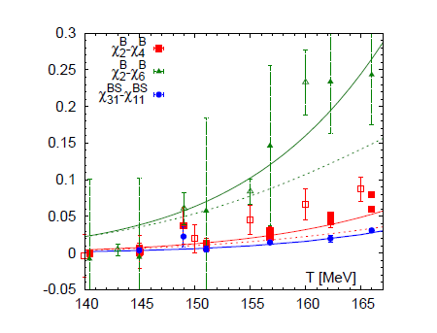
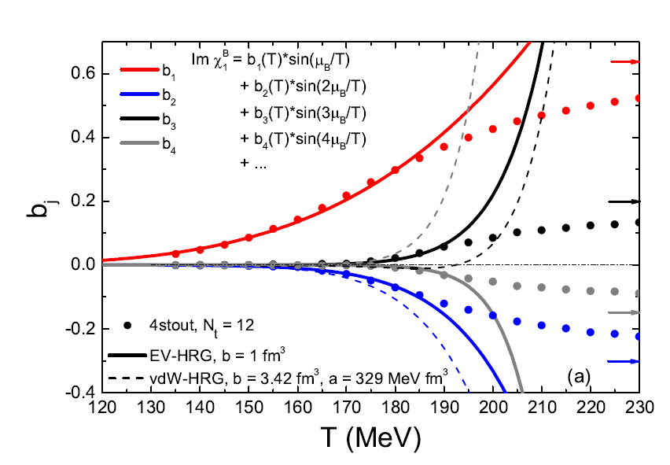
Phenomenology: Short range repulsion dominates
[Huovinen, Petreczky PLB777 (2017)]
[Vovchenko, Pásztor et al, PLB 775 (2017)]
Important scale: 1-3.5fm³
Not all relevant phase shift are known experimentally, but the NN is known, and
If one substitutes it to the S-matrix formalism, it turns out that the repulsive core
of the NN interaction dominates the first correction to the HRG.
In a phenomenological model that includes both short range repulsion and long
range attraction for all baryons, it is the short range repulsion that dominates the
first correction.

Slide 16
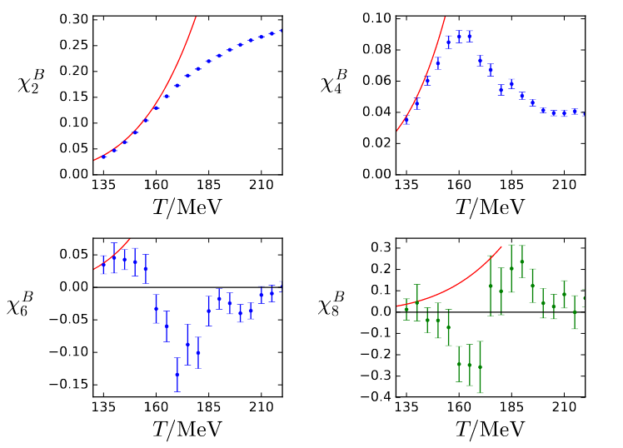
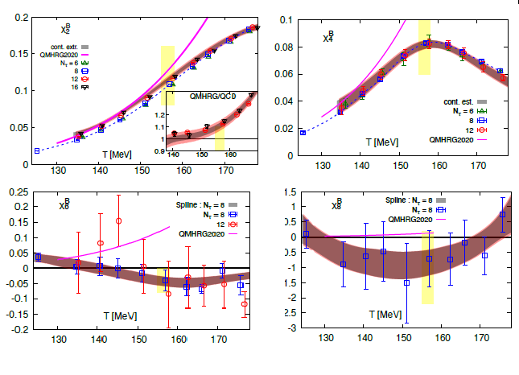
Taylor coefficients of the pressure
From imaginary chemical potential
From zero chemical potential
[Wuppertal-Budapest, JHEP (2018)]
(LT=4, N_{t}=12)
[HotQCD, PRD105 (2022)]
(LT=4, N_{t}=6,8,(12))

Slide 17
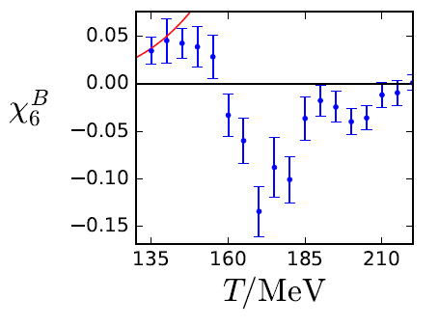
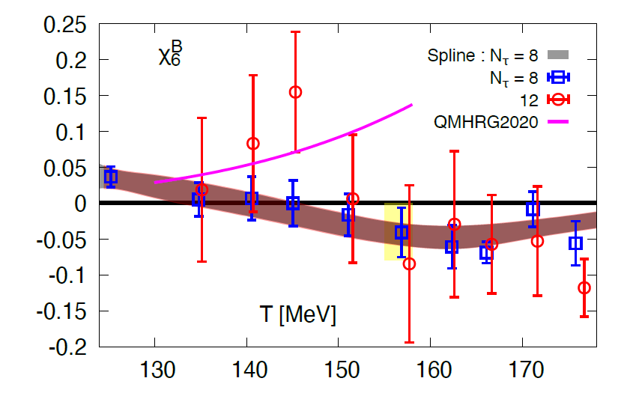
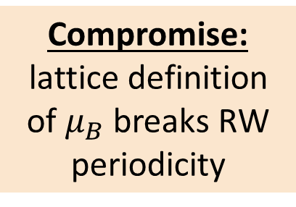
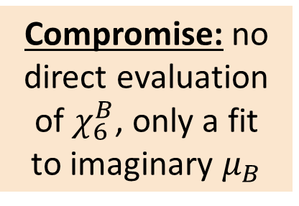
6th order: zoom in to see discrepancies
From imaginary chemical potential
From zero chemical potential (Taylor)
Compromise: no
direct evaluation
of $χ_{6}^{B}$, only a fit
to imaginary $μ_{B}$
Compromise: lattice definition of $μ_{B}$ breaks RW
periodicity
[Wuppertal-Budapest, JHEP (2018)] (LT=4, N_{t}=12)
[HotQCD, PRD105 (2022)] (LT=4, N_{t}=8,(12))
- N_{t}=12 (left, WB) agrees with the HRG (value, slope) better than N_{t}=8 (right, HotQCD) at low T
- At T=145-155MeV: N_{t}=12>0 and N_{t}=8<0

Slide 18
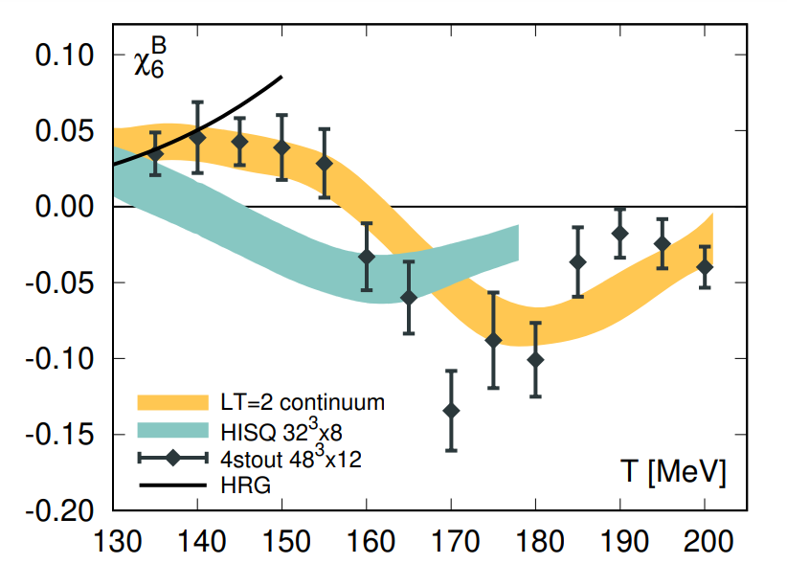
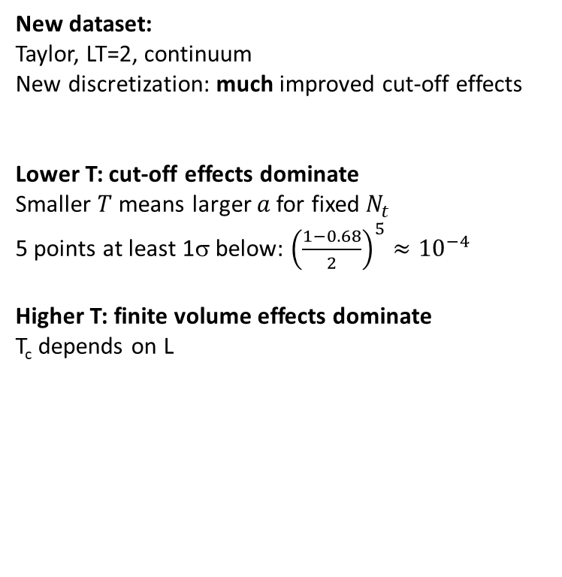
6th order order: new dataset
New dataset:
Taylor, LT=2, continuum
New discretization: much improved cut-off effects
Lower T: cut-off effects dominate
Smaller $T$ means larger $a$ for fixed $N_{t}$
5 points at least 1σ below: ${\left(\frac{1−0.68}{2}\right)}^{5}≈{10}^{−4}$
Higher T: finite volume effects dominate
T_{c} depends on L
145MeV<T: HRG ≠ LATTICE
130MeV<T<145MeV: HRG ≈ LATTICE
(within errors)

Slide 19
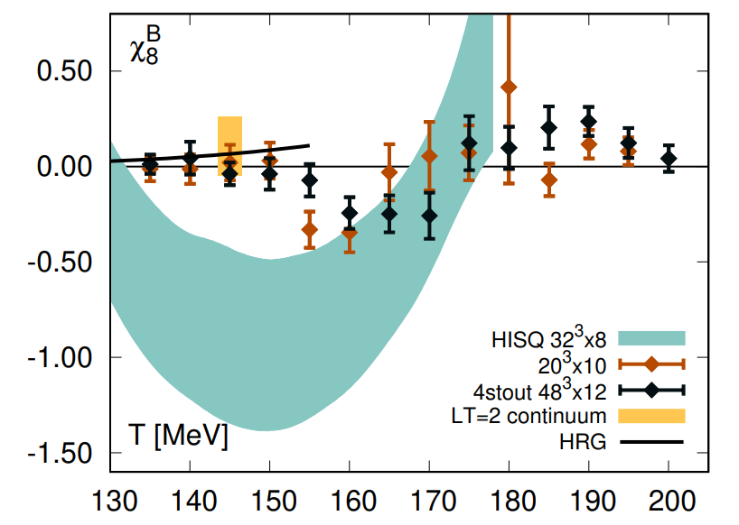
6th and 8th order order: new dataset

Slide 20
How small is LT=2?
We cannot know for sure without simulating at larger volumes. But we can try to guess based on phenomenology.
T=145MeV
V≈20fm³ ≈ 6-20X(excluded volume)
m_{π}L ≈ 1.9
T=130MeV
V≈28fm³ ≈ 8-28X(excluded volume)
m_{π}L ≈ 2.2
T=120MeV
V≈35fm³ ≈ 10-35X(excluded volume)
m_{π}L ≈ 2.3
Likely large enough to correctly capture short range repulsion between baryons but not the long range attraction.

Slide 21
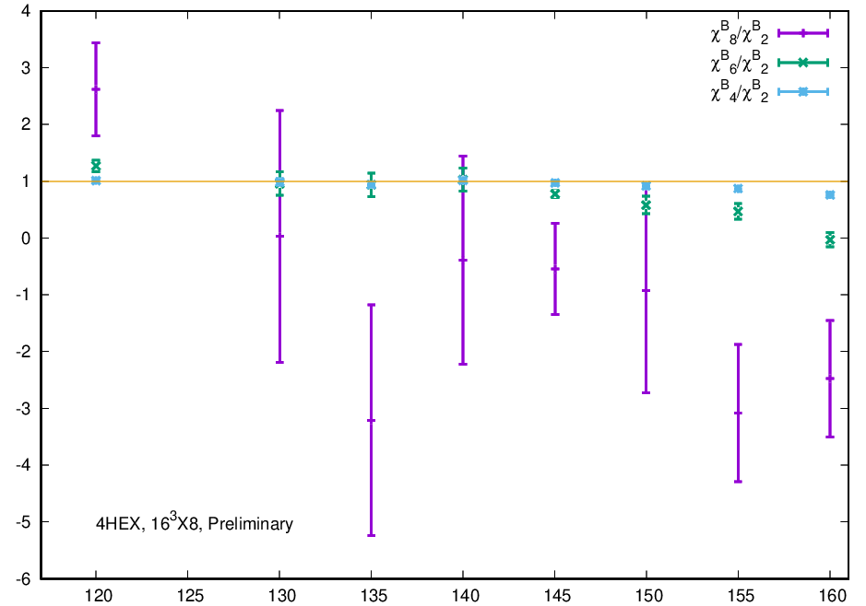

Going to lower temperatures
Deviations from HRG!
$χ_{4}^{B}<χ_{6}^{B}$< $χ_{8}^{B}$

Slide 22
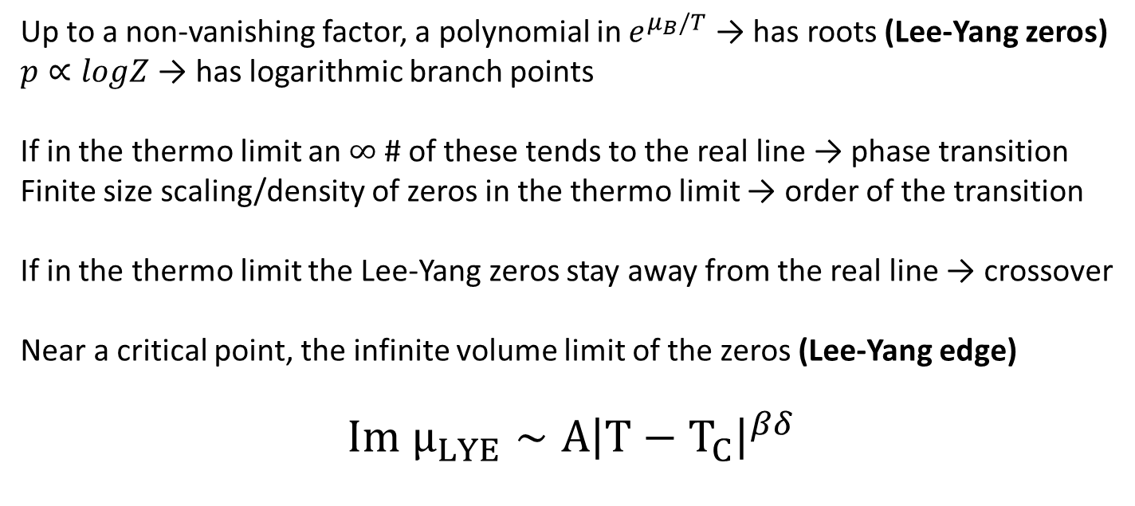
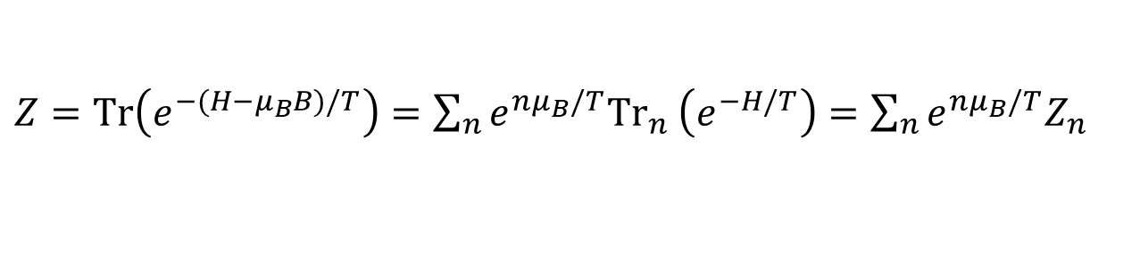
Lee-Yang zeros
$Z=Tr\left(e^{−(H−μ_{B}B)/T}\right)=\sum_{n}{e^{nμ_{B}/T}{Tr}_{n}}$ $\left(e^{−H/T}\right)=\sum_{n}{e^{nμ_{B}/T}Z_{n}}$
Up to a non-vanishing factor, a polynomial in $e^{μ_{B}/T}$ → has roots (Lee-Yang zeros)
$p∝logZ$ → has logarithmic branch points
If in the thermo limit an $∞$ # of these tends to the real line → phase transition
Finite size scaling/density of zeros in the thermo limit → order of the transition
If in the thermo limit the Lee-Yang zeros stay away from the real line → crossover
Near a critical point, the infinite volume limit of the zeros (Lee-Yang edge)
$$Im μ_{LYE}∼A{\left|T−T_{C}\right|}^{βδ}$$

Slide 23
Lots of recent activity on LY zeros
[Giordano & Pásztor, PRD99(2019)]
[Giordano, Kapas, Katz, Nógrádi, Pásztor, PRD101 (2020)]
[Mukherjee & Skokov, PRD103 (2021)]
[Dimopoulos et al, PRD105 (2022)]
[Basar, 2312.06925]
[Goswami et al, 2401.05651]
NONE OF THEM HAD WELL CONTROLLED
LATTICE RESULTS BELOW T_{CROSSOVER}

Slide 24


Trying to extrapolate a CEP
1. WRITE RATIONAL APPROXIMATION FOR BARYON NUMBER SUSCEPTIBILITY
$χ_{2}^{B}\left(μ_{B}\right)≈χ_{2}^{B}\left(0\right)$ + $χ_{4}^{B}\left(0\right)\frac{{\hat{μ}}_{B}^{2}}{2}$+ $χ_{6}^{B}\left(0\right)\frac{{\hat{μ}}_{B}^{4}}{4!}$ + $χ_{8}^{B}\left(0\right)\frac{{\hat{μ}}_{B}^{6}}{6!}≈\frac{a+bμ_{B}^{2}}{1+cμ_{B}^{2}+dμ_{B}^{4}}$
2. FIND THE POLES
3. EXTRAPOLATE THE CRITICAL TEMPERATURE WITH
MANY CAVEATS:
At 130MeV we had a larger volume to cross-check the negligibility of finite-volume effects, at 120MeV we only have the small volume to go with
We have a finite order Taylor to construct the Padé approximants, we have no higher order correction (yet) with which to cross-check truncation effects
We assume the asymptotic scaling form of the imaginary part of the Lee-Yang edge up to high temperatures
$$Im μ_{LYE}∼A{\left|T−T_{C}\right|}^{βδ}$$
At least one slightly larger volume should be doable
Essentially the same as [Basar, 2312.06925] and [Goswami et al, 2401.05651]
Can be remedied with ${Imμ}_{B}$
Can be relaxed once data gets better

Slide 25
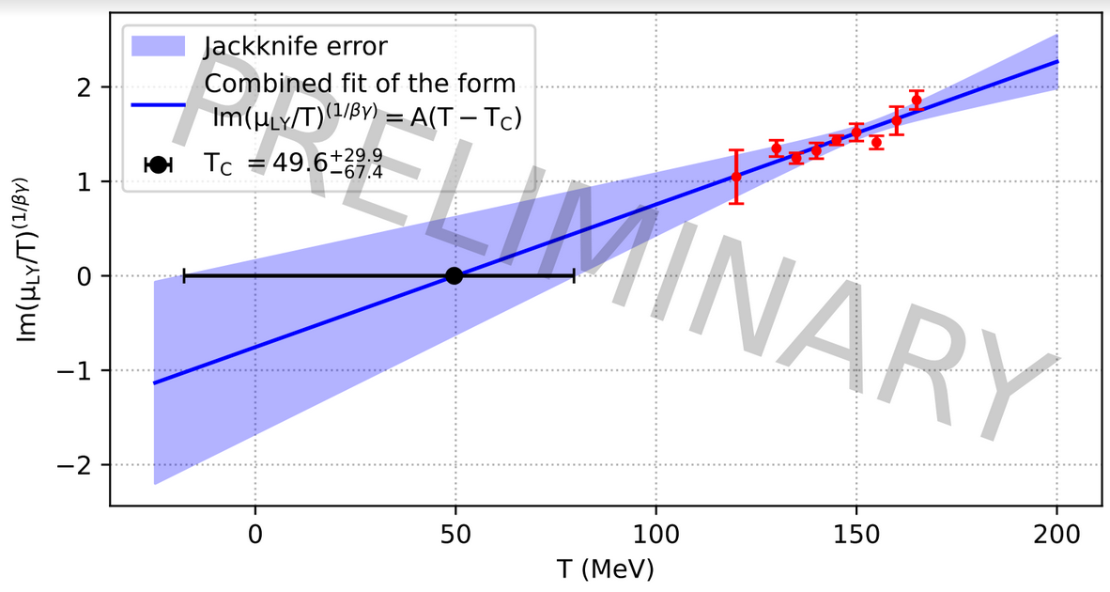
Trying to extrapolate a CEP
The Lee-Yang zero does move towards the real axis (Very good news!)
However, at this point this is consistant both with:
  chiral/deconfinement CEP at say T=70MeV
  nuclear liquid-gas CEP as say T=10MeV
A GENERAL PROBLEM WITH
ONLY USING BARYON NUMBER

Slide 26
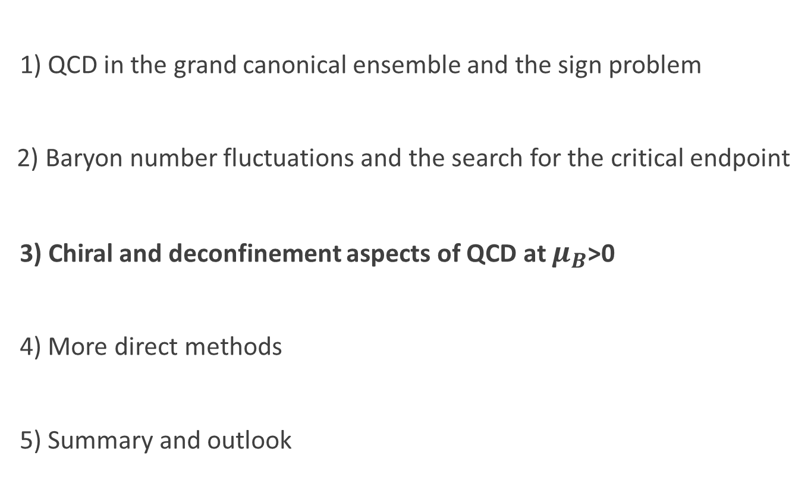
Outline
1) QCD in the grand canonical ensemble and the sign problem
2) Baryon number fluctuations and the search for the critical endpoint
3) Chiral and deconfinement aspects of QCD at $μ_{B}$>0
4) More direct methods
5) Summary and outlook

Slide 27
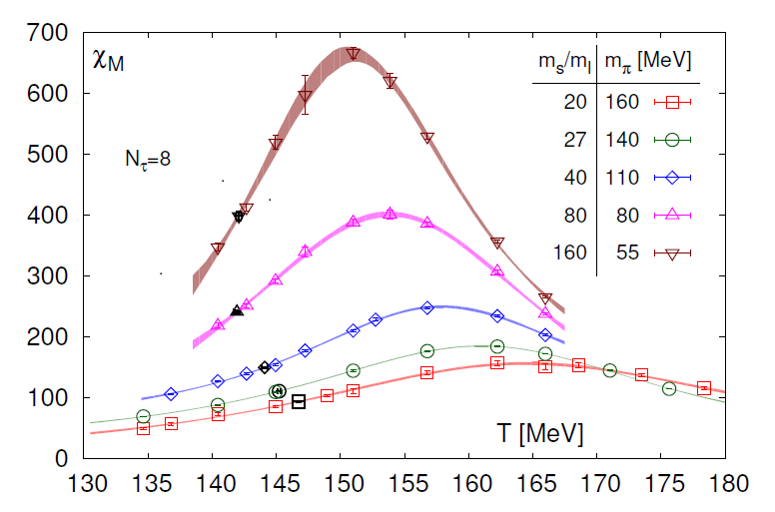

Chiral criticality and the equation of state
Smaller-than-physical quark mass @ $μ_{B}=0$
Plot from [HotQCD, PRL123 (2019)]
See also [Kotov, Lombardo, Trunin, PLB823 (2021)]:
scaling for heavier-than-physical quark masses

Slide 28
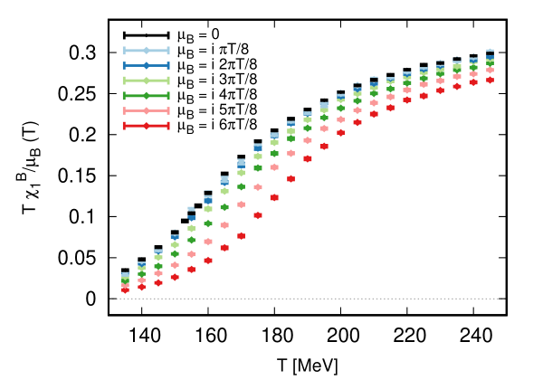
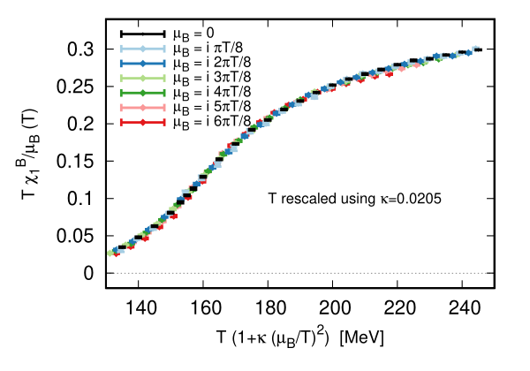

Chiral criticality and the equation of state
T and $μ_{B}$ dependence with physical masses
Empirically: approximate scaling variable $T\left(1+κ_{2}{\hat{μ}}_{B}^{2}\right)$
⇒ transition not sharpening for small ${\hat{μ}}_{B}^{2}$
[Wuppertal-Budapest, PRL126 (2021)]
I strongly suspect that the mechanism behind this collapse is chiral scaling.

Slide 29
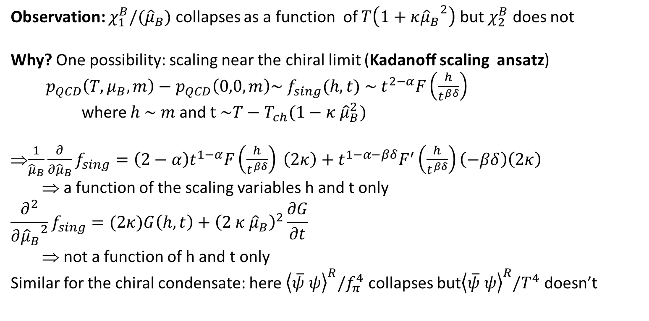
O(4) scaling and collapse plots at µ_{B}>0
Observation: $χ_{1}^{B}/({\hat{μ}}_{B})$ collapses as a function of $T\left(1+κ{{\hat{μ}}_{B}}^{2}\right)$ but $χ_{2}^{B}$ does not
Why? One possibility: scaling near the chiral limit (Kadanoff scaling ansatz)
$p_{QCD}\left(T,μ_{B},m\right)−p_{QCD}\left(0,0,m\right)\sim f_{sing}(h,t) \sim t^{2−α}F\left(\frac{h}{t^{βδ}}\right)$
where $h \sim m$ and $t \sim T−T_{ch}(1−κ {\hat{μ}}_{B}^{2})$
$\frac{1}{{\hat{μ}}_{B}}\frac{∂}{∂{\hat{μ}}_{B}}f_{sing}=\left(2−α\right)t^{1−α}F\left(\frac{h}{t^{βδ}}\right) \left(2κ\right)+t^{1−α−βδ}F^{′}\left(\frac{h}{t^{βδ}}\right)\left(−βδ\right)\left(2κ\right)$
⇒ a function of the scaling variables h and t only
$$\frac{∂^{2}}{∂{{\hat{μ}}_{B}}^{2}}f_{sing}=(2κ)G\left(h,t\right)+{\left(2 κ {\hat{μ}}_{B}\right)}^{2}\frac{∂G}{∂t}$$
⇒ not a function of h and t only
Similar for the chiral condensate: here ${\left\langle \overline{ψ} ψ\right\rangle }^{R}/f_{π}^{4}$ collapses but${\left\langle \overline{ψ} ψ\right\rangle }^{R}/T^{4}$ doesn’t
STRUCTURES IN THE BARYON NUMBER SUSCEPTIBILITIES AROUND THE CROSSOVER ARE LIKELY RELATED TO CHIRAL SYMMETRY

Slide 30
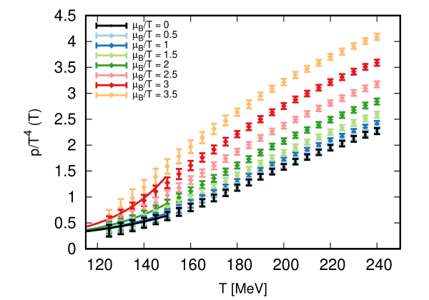

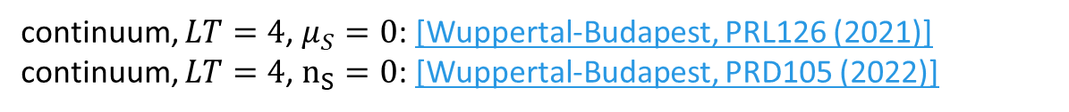
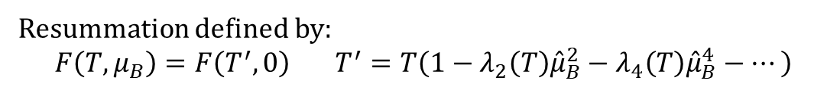
Alternative expansion scheme
Approximate collapse in the Im(µ_{B}) data
Account for small deviations systematically, extrapolate to real µ_{B}
Resummation defined by:
$$F\left(T,μ_{B}\right)=F\left(T^{′},0\right) T^{′}=T\left(1−λ_{2}\left(T\right){\hat{μ}}_{B}^{2}−λ_{4}\left(T\right){\hat{μ}}_{B}^{4}−…\right)$$
continuum, $LT=4$, $μ_{S}=0$: [Wuppertal-Budapest, PRL126 (2021)]
continuum, $LT=4$, $n_{S}=0$: [Wuppertal-Budapest, PRD105 (2022)]
Also, small nonzero $n_{S}$

Slide 31
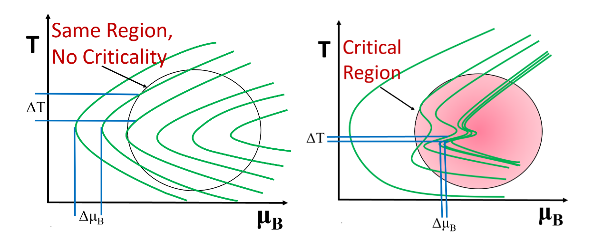
Critical lensing
Sketch from [Dore et al, PRD106 (2022)]

Slide 32
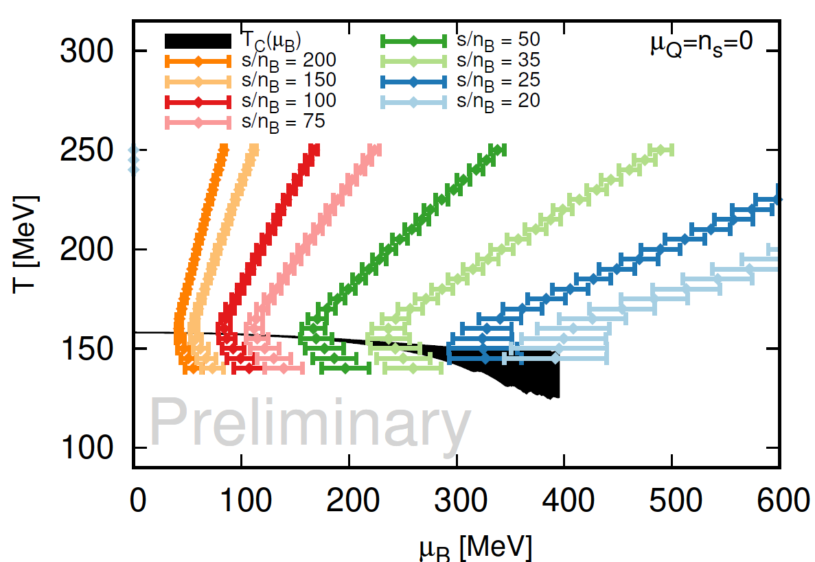
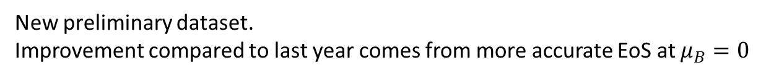
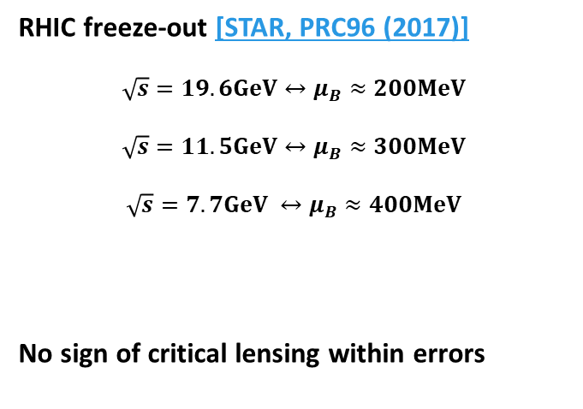
EoS from extrapolations
Isentropes (resummation)
RHIC freeze-out [STAR, PRC96 (2017)]
$$\sqrt{s}=19.6GeV↔μ_{B}≈200MeV$$
$$\sqrt{s}=11.5GeV↔μ_{B}≈300MeV$$
$$\sqrt{s}=7.7GeV ↔μ_{B}≈400MeV$$
No sign of critical lensing within errors
?
New preliminary dataset.
Improvement compared to last year comes from more accurate EoS at $μ_{B}=0$

Slide 33
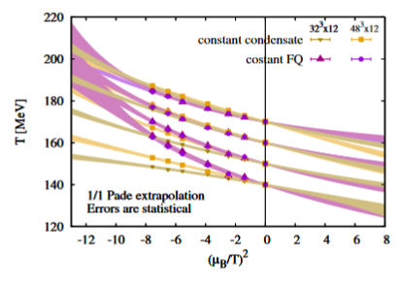
Confinement less sensitive to volume
PRELIMINARY
PLAN: SUPPLEMENT ANALYSIS OF THE BARYON FLUCTUATIONS
WITH AN ANALYSIS OF CONFINEMENT RELATED QUANTITIES

Slide 34
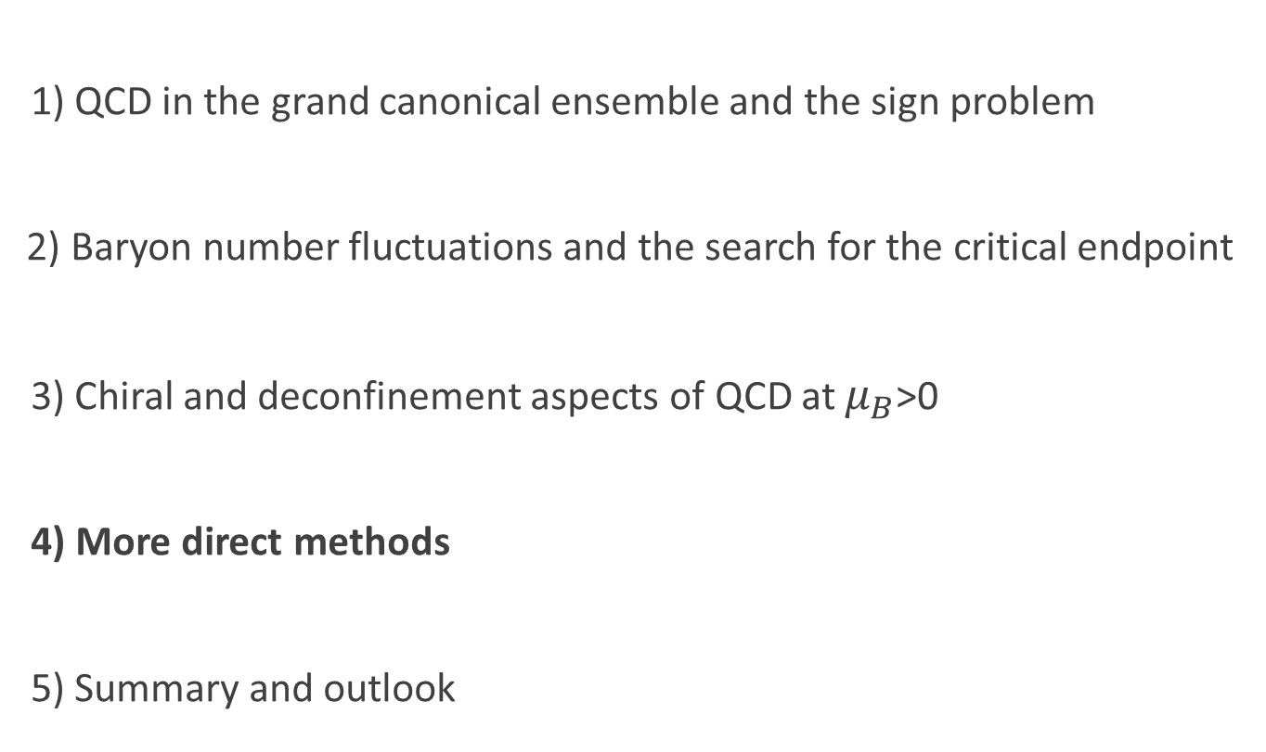
Outline
1) QCD in the grand canonical ensemble and the sign problem
2) Baryon number fluctuations and the search for the critical endpoint
3) Chiral and deconfinement aspects of QCD at $μ_{B}$>0
4) More direct methods
5) Summary and outlook

Slide 35

Reweighting
Fields: $φ$ Target theory: $Z_{t}=\int{Dφ{ w}_{t}(φ)}$ Simulated theory: $Z_{s}=\int{Dφ{ w}_{s}(φ)}$
${\left\langle O\right\rangle }_{t}=\frac{\int{Dφ{ w}_{t}\left(φ\right)}O(φ)}{\int{Dφ{ w}_{t}\left(φ\right)}}=\frac{\int{Dφ\frac{{ w}_{t}\left(φ\right)}{{ w}_{s}\left(φ\right)}{ w}_{s}\left(φ\right)}O(φ)}{\int{Dφ{\frac{{ w}_{t}\left(φ\right)}{{ w}_{s}\left(φ\right)}w}_{s}\left(φ\right)}}=\frac{{\left\langle \frac{w_{t}}{w_{s}}O\right\rangle }_{s}}{{\left\langle \frac{w_{t}}{w_{s}}\right\rangle }_{s}}$ and $\frac{Z_{t}}{Z_{s}}={\left\langle \frac{w_{t}}{w_{s}}\right\rangle }_{s}$
Two problems (usually exponentially hard in the volume) can arise:
- sign problem: $\frac{w_{t}}{w_{s}}∈$ ⇒ large signal to noise ratios
- overlap problem: tails of $P\left(\frac{w_{t}}{w_{s}}\right)$ do not decay fast enough ⇒ potentially incorrect results
Two choice of $w_{s}$ that eliminate this overlap problem:
- phase reweighting: $w_{s}=e^{−S_{YM}}\left|\det{M}\right|$ ⇒ $\frac{Z_{t}}{Z_{s}}={\left\langle e^{i θ}\right\rangle }_{s}$
- sign reweighting: $w_{s}=e^{−S_{YM}}|Re det{M}|$ ⇒ $\frac{Z_{t}}{Z_{s}}={\left\langle ±\right\rangle }_{s}$

Slide 36

Some recent reweighting results
Cross-check approximate scaling
[Borsányi et al, PRD 105 (2022)]

Slide 37

Some recent reweighting results
Cross-check QGP EoS
[Borsányi et al, PRD 107 (2023)]
Resummation based on approximate scaling converges one order faster than the Taylor expansion

Slide 38



Staggered rooting and low T difficulties
Say I want N_{f}=2+1 with staggered: $Z=\int{DU{\left(\det{M_{ud}\left(U,μ\right)}\right)}^{\frac{1}{2}}{\left(\det{M_{s}\left(U\right)}\right)}^{\frac{1}{4}}}e^{−S_{YM}(U)}$
Determinant complex, so sqrt ambiguous.
Standard choice: continuously connect to the positive root at µ=0
We empirically observe that this leads to non-analytic behavior (essential singularity) at µ=0
The non-analytic part is suppressed for µ<m_{π}
The amplitude of the non-analytic part decreases with the lattice spacing
WE ARE CURRENTLY WORKING ON A NOVEL DISCRETIZATION THAT DOES NOT REQUIRE ROOTING

Slide 39
Summary and outlook
Analytic continuation methods:
- Baryon number fluctuations to 8th order below T_{crossover} (in a small volume) show signs of a strengthening transition
- At the moment consistent both with a chiral and a nuclear liquid-gas CEP
- On the other hand, 4th (and 6th) order fluctuations near the crossover show signs of being sensitive to chiral symmetry
- This gives me hope that the strengthening we see is due to a chiral CEP
- Confinement related quantities seem to be less susceptible to volume effects then chiral symmetry related quantities
- So my strategy forward: make the baryon flucuation data and analysis more precise, and also analyze confinement related quantities
Reweighting methods:
- Made me confident about our extrapolations of the QGP EoS at large T
- To make them applicable to low T we need a different discretization

