Slide 1
Ez+az polimerláncokról, polimergyűrűkről
Bolyai Kollégium
fizika szeminárium
2019. október 1.
Kürti Jenő
ELTE
Fizikai Intézet
Biológiai Fizika Tanszék
e-mail: kurti@virag.elte.hu www: regivirag.elte.hu/kurti

Slide 2
1
INTRODUCTION

Slide 3
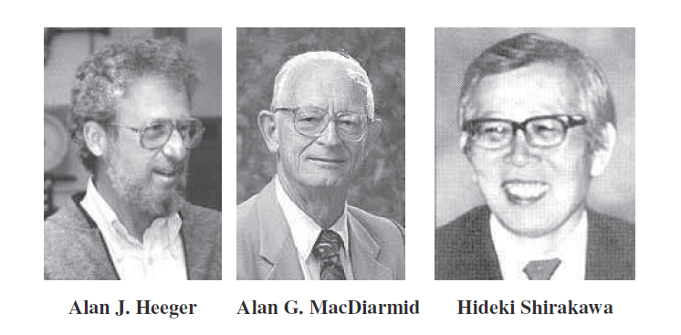
Nobel Prize in Chemistry, 2000
for the discovery of polyacetylene
(prototype of the family of conjugated polymers)
1936- 1927-2007 1936-

Slide 4
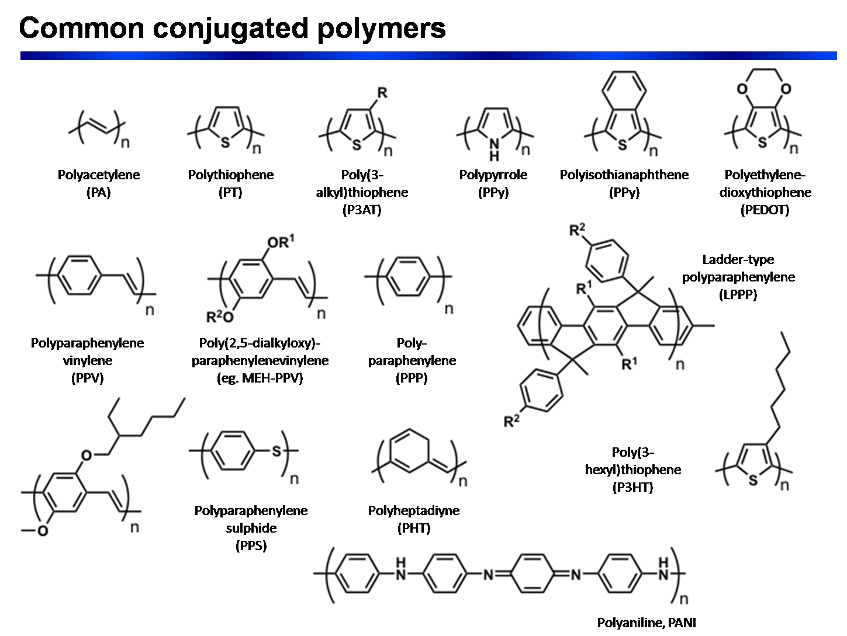
wikipedia

Slide 5
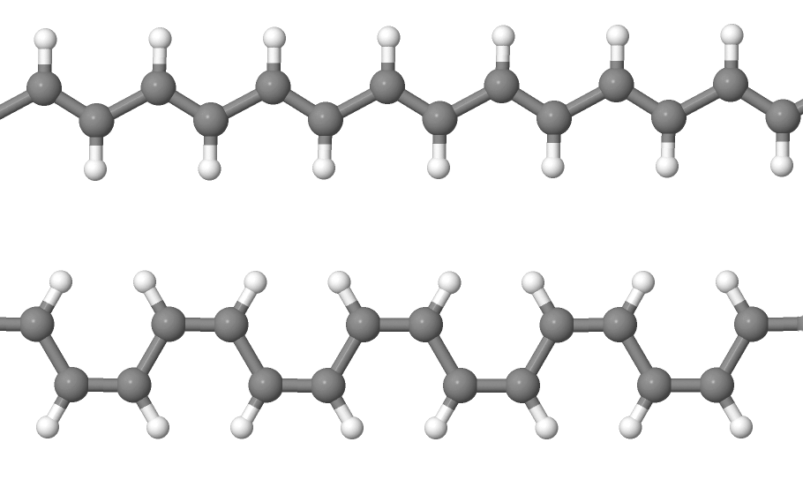
polyacetylene
trans (trans-transoid)

Slide 6
polyacetylene
trans (trans-transoid)
cis (cis-transoid)

Slide 8
Bond Length Alternation: BLA _{i} = |r_{i+1} – r_{i}|
r_{i+1}
r_{i}
physics student : BLA = 0

Slide 9
Bond Length Alternation: BLA _{i} = |r_{i+1} – r_{i}|
r_{i+1}
r_{i}
physics student : BLA = 0
chemistry student : BLA = R₁ – R₂ ≈ 21 pm

Slide 10
finite oligomer: chain end effects

Slide 11
finite oligomer: chain end effects

Slide 12
finite oligomer: chain end effects

Slide 13
infinite polymer: ???

Slide 14
2
LHS model

Slide 15
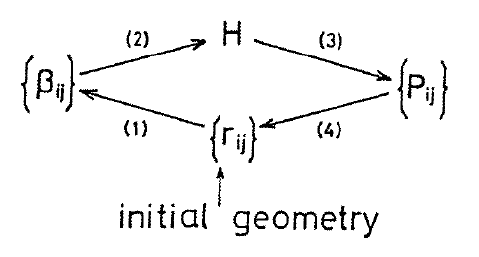
LHS model: Hückel theory with geometry (bond length) optimization
(Longuet-Higgins, Salem; 1959)
p_{m} (mobile) bond order:
MO - LCAO
Coulson relation

Slide 16
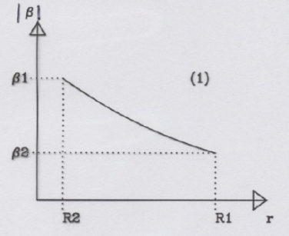
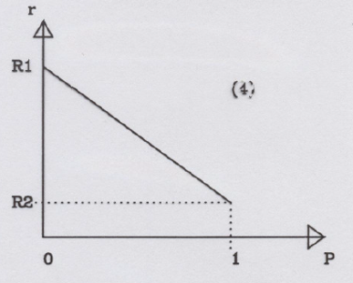
LHS model: Hückel theory with geometry (bond length) optimization
(Longuet-Higgins, Salem; 1959)
p_{m} (mobile) bond order:
MO - LCAO
Coulson relation

Slide 17
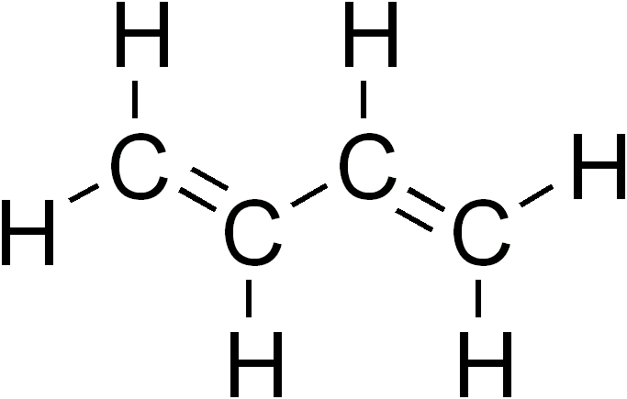
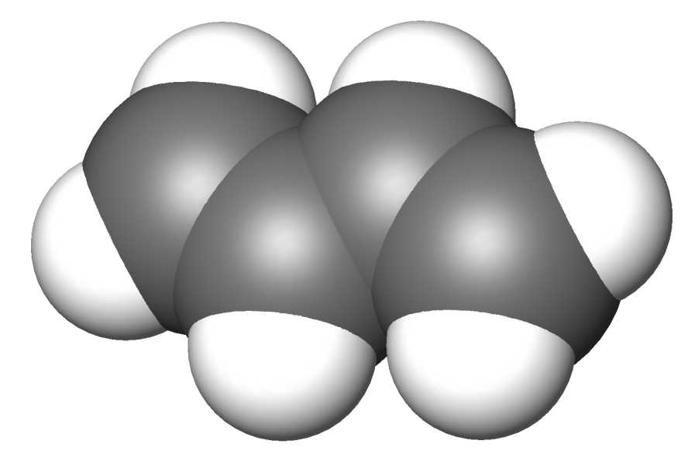
trans-butadiene
( C₄H₆ )
r₁
r₃
r₂

Slide 18
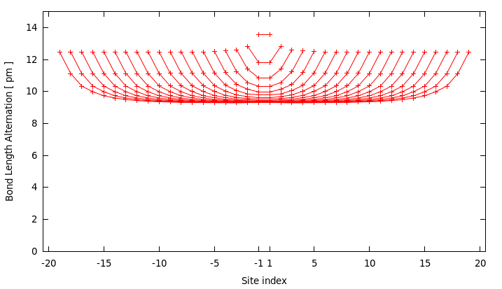
LHS results for BLA along C_{2n}H_{2n+2} chains
n=2
n=3
n=10

Slide 19
LHS results for BLA along C_{2n}H_{2n+2} chains
n=2
n=3

Slide 20
LHS results for BLA along C_{2n}H_{2n+2} chains
n=2
n=3
n=4

Slide 21
LHS results for BLA along C_{2n}H_{2n+2} chains
n=2
n=3
n=4
n=10
n=20
infinite limit: Peierls-distortion
BLA ≈9 pm

Slide 22
Bond Length Alternation: BLA _{i} = |r_{i+1} – r_{i}|
r_{i+1}
r_{i}
physics student (not well educated): BLA = 0 ☹
chemistry student (average) : BLA = R₁ – R₂ ≈ 21 pm K
physics student (well educated): 0 ≤ BLA ≈ 9 pm ≤ R₁ – R₂ J
Peierls-distortion

Slide 23
3
Finite hydrocarbon rings: annulene molecules
(e.g. benzene)

Slide 24
BENZENE AND THE AROMATIC STRUCTURE
4n+2 π-electrons (n=1)
2x degenerated HOMO occupied
2x degenerated LUMO empty
high stability
equidistant: r_{CC}=1.39 Å
NO BLA
picture from Sándor Pekker

Slide 25
There is NO BLA in benzene!
BUT
What happens when
increasing the number of atoms
in the ring ?!

Slide 26
4n + 2 (aromatic)
vs
4n (antiaromatic)
structures

Slide 27
CYCLOBUTADIENE
AND THE ANTIAROMATIC STRUCTURE
4n π-electrons (n=1)
2x degenerated HOMO partially occupied
equidistant state: open shell, unstable
Jahn-Teller distortion → strong BLA
picture from Sándor Pekker

Slide 28
CYCLOBUTADIENE
AND THE ANTIAROMATIC STRUCTURE
4n π-electrons (n=1)
2x degenerated HOMO partially occupied
equidistant state: open shell, unstable
Jahn-Teller distortion → strong BLA
picture from Sándor Pekker

Slide 29
4
LHS calculations

Slide 30
4n (antiaromatic) case

Slide 31
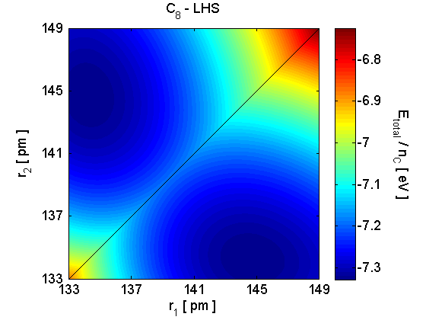

Slide 32
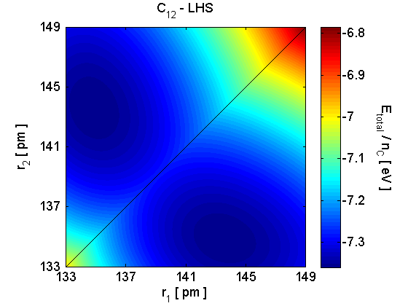

Slide 33
4n+2 (aromatic) case

Slide 34
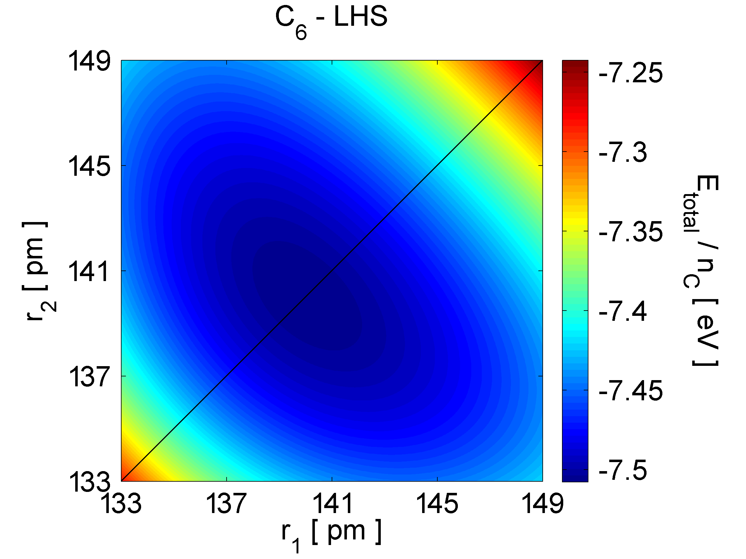

Slide 35
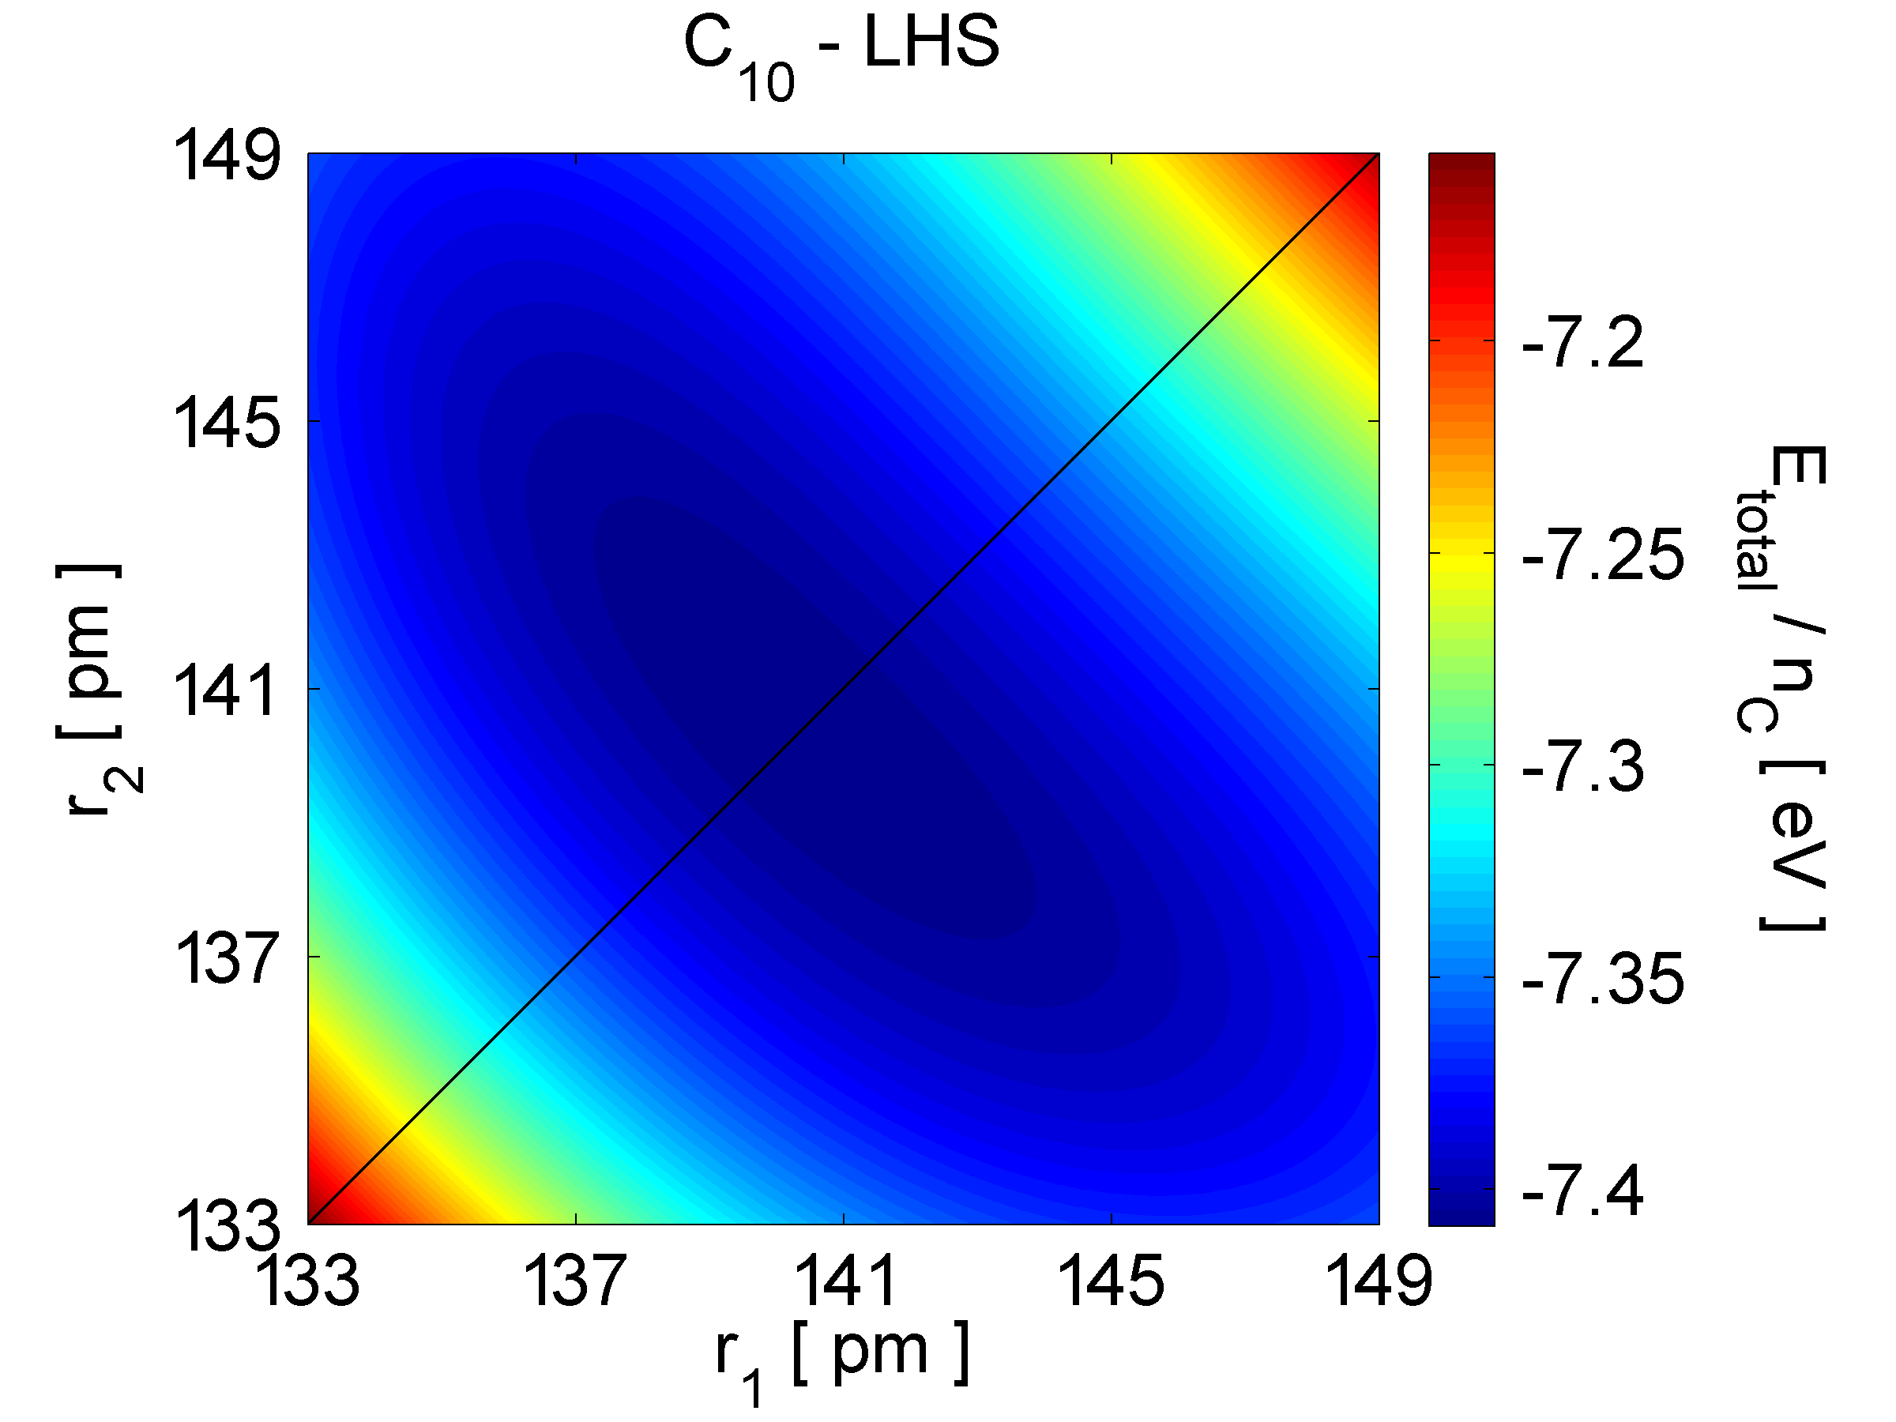

Slide 36
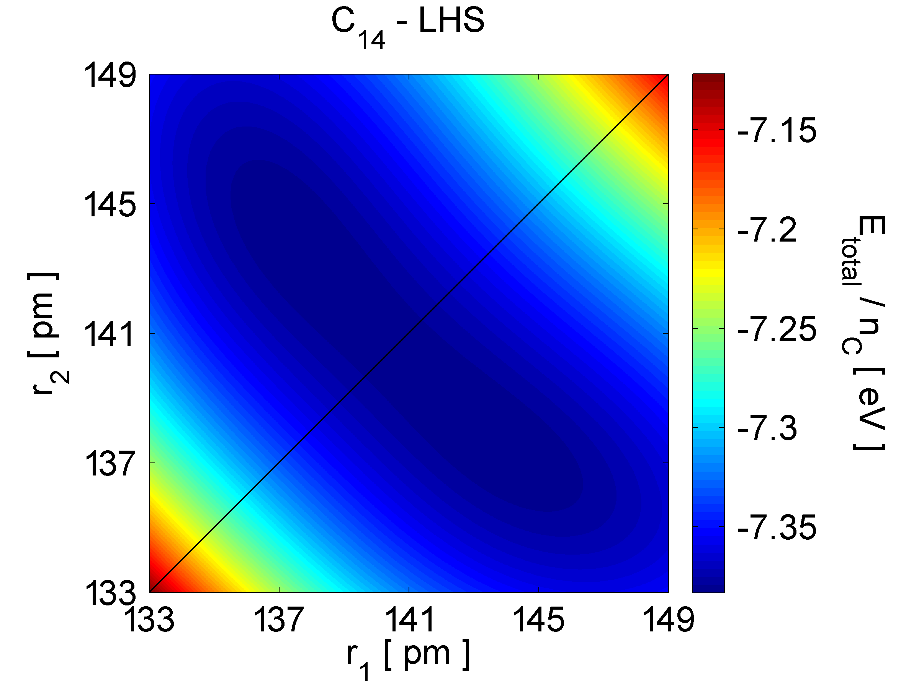

Slide 40
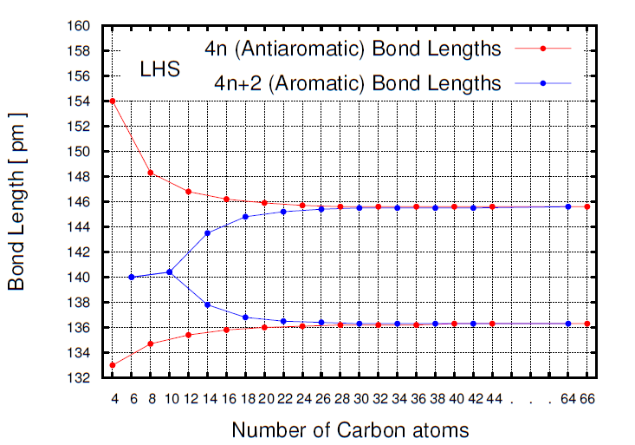
BLA ≈9 pm

Slide 41
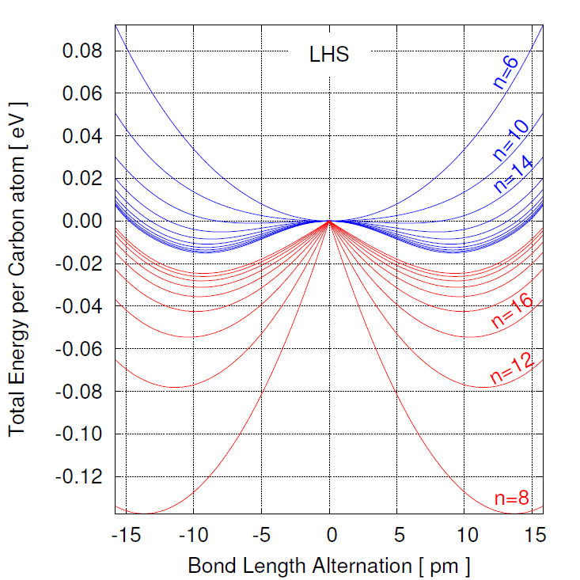
aromatic:
pseudo Jahn-Teller
anti-aromatic:
Jahn-Teller

Slide 42
5
DFT calculations:
G09 package, B3LYP/6-31G(d,p) functional

Slide 43
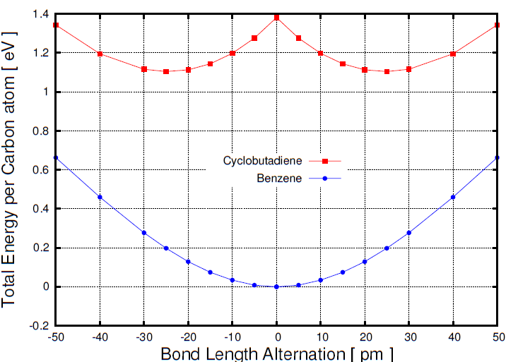
DFT
JT

Slide 44
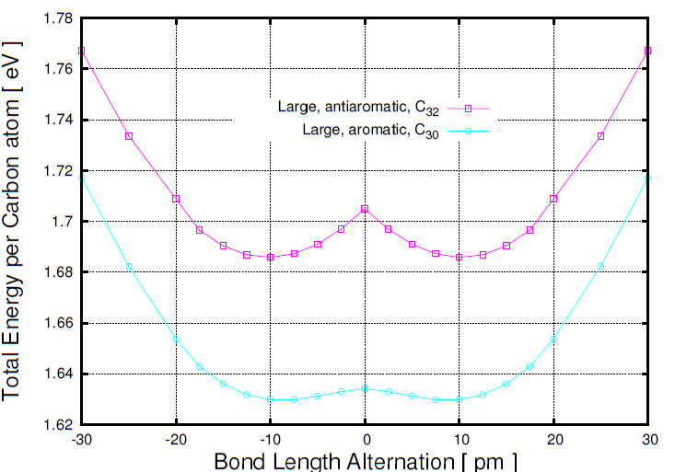
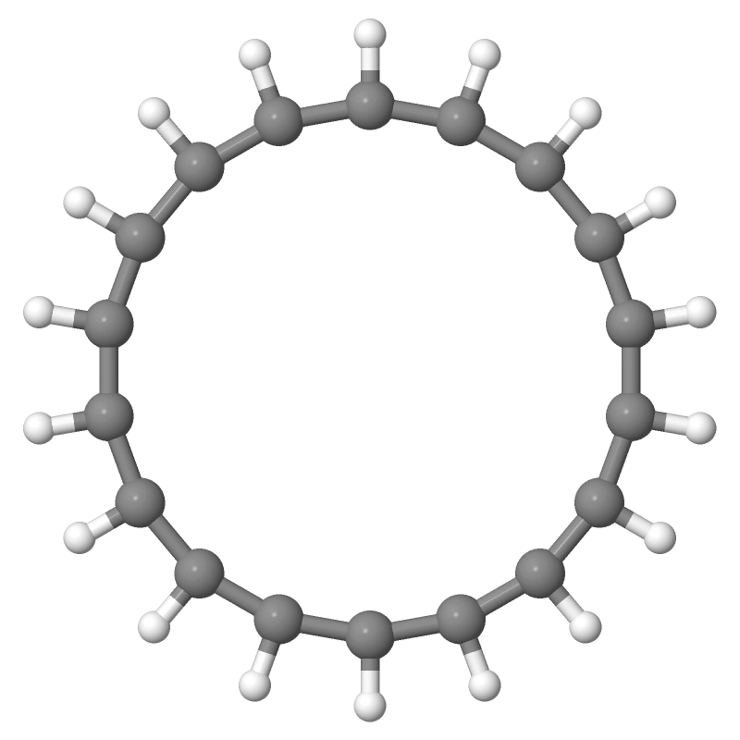
DFT
all-cis
JT
PJT

Slide 45
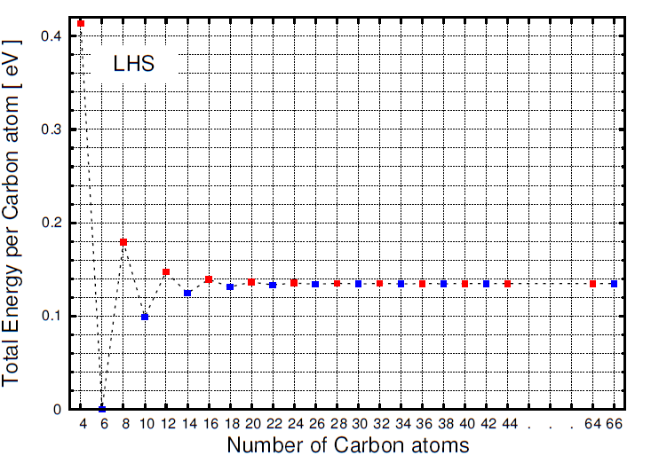

Slide 46
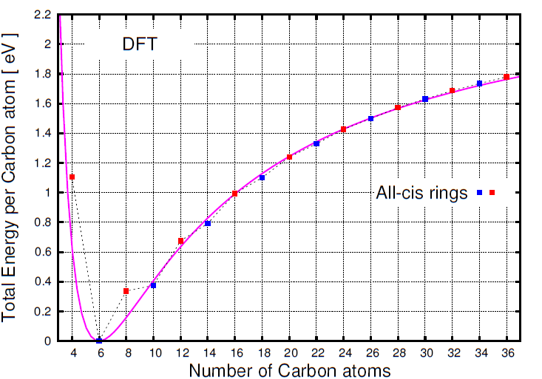
Effect of angle strain

Slide 47
6
Aromatic annulene rings investigated

Slide 48
18[annulene]
planar all-cis

Slide 49
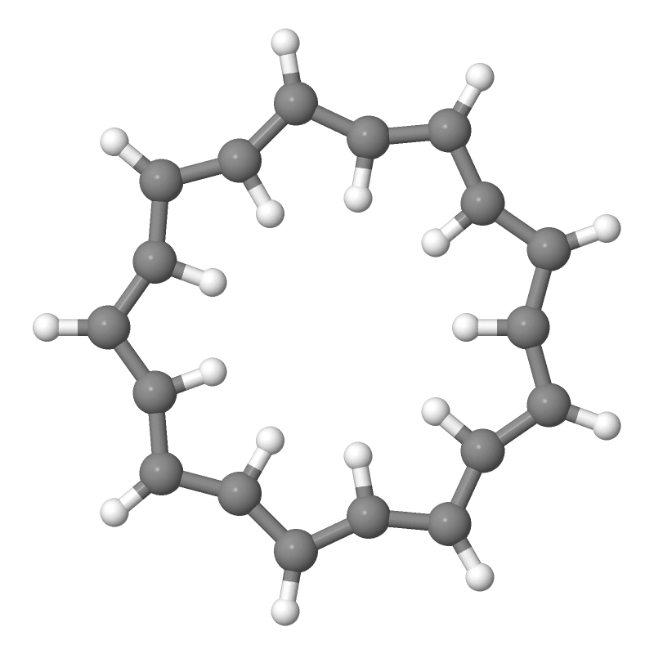
18[annulene]
planar all-trans

Slide 50
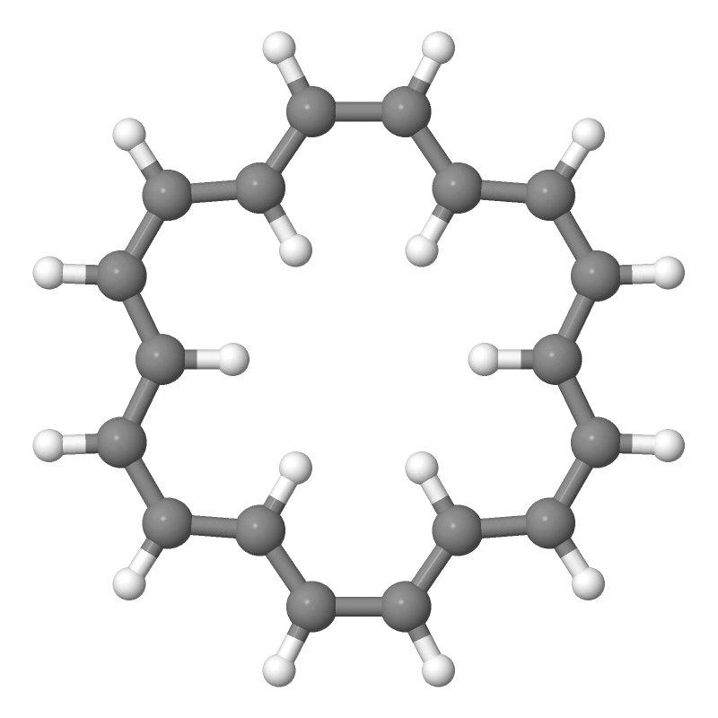
18[annulene]
D_{6h} symmetry

Slide 51
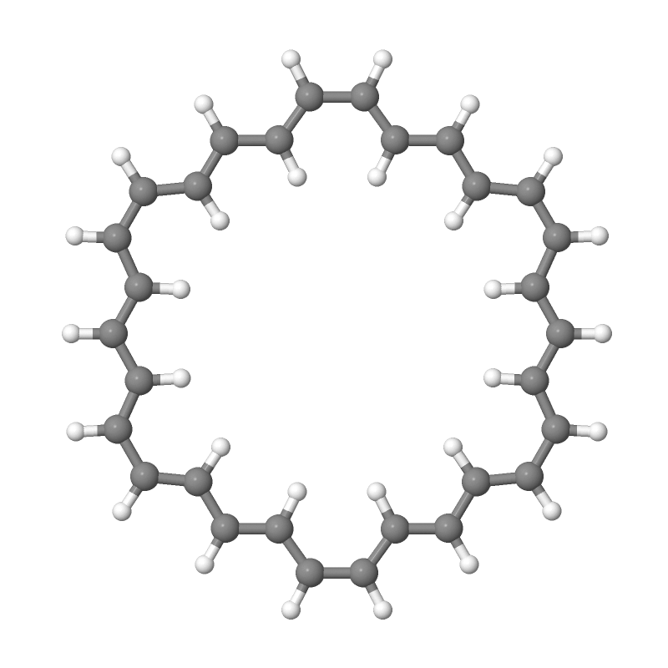
30[annulene]
D_{6h} symmetry

Slide 52
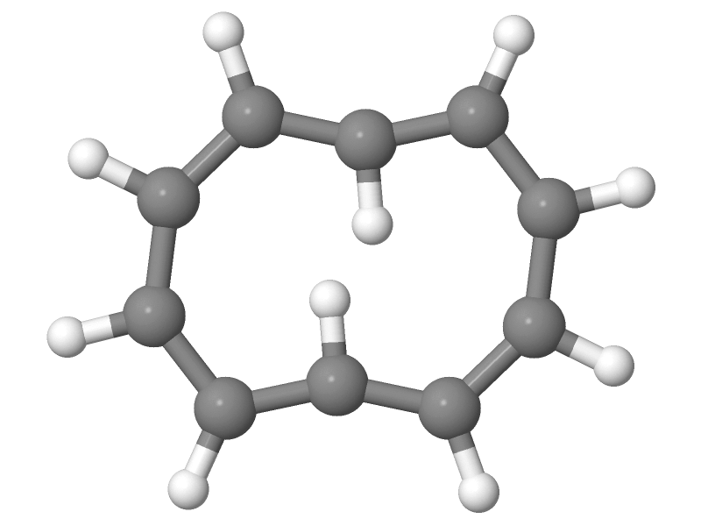
10[annulene]
planar optimized in 2D

Slide 53
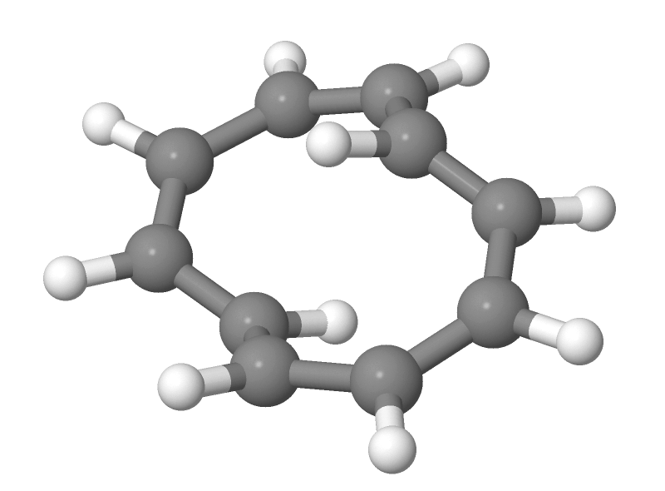
10[annulene]
non-planar, optimized in 3D

Slide 54
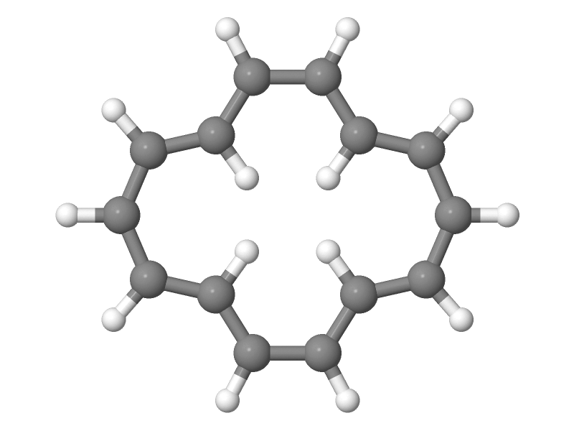
14[annulene]
planar, optimized in 2D

Slide 55
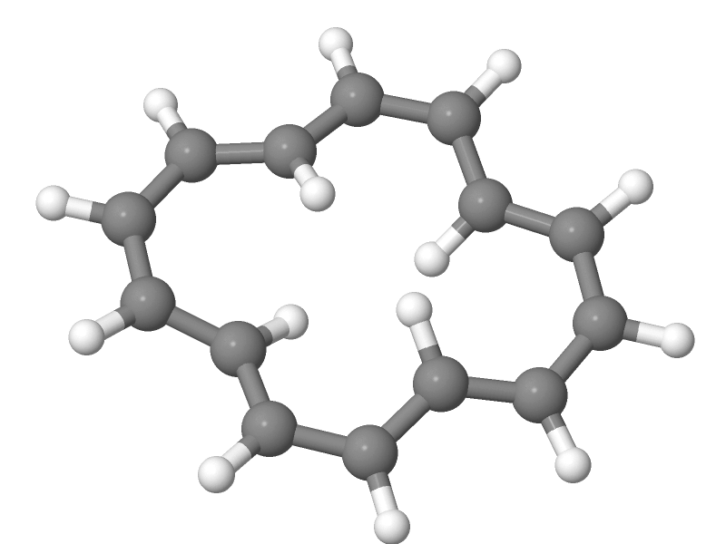
14[annulene]
non-planar, optimized in 3D

Slide 56
!

Slide 57
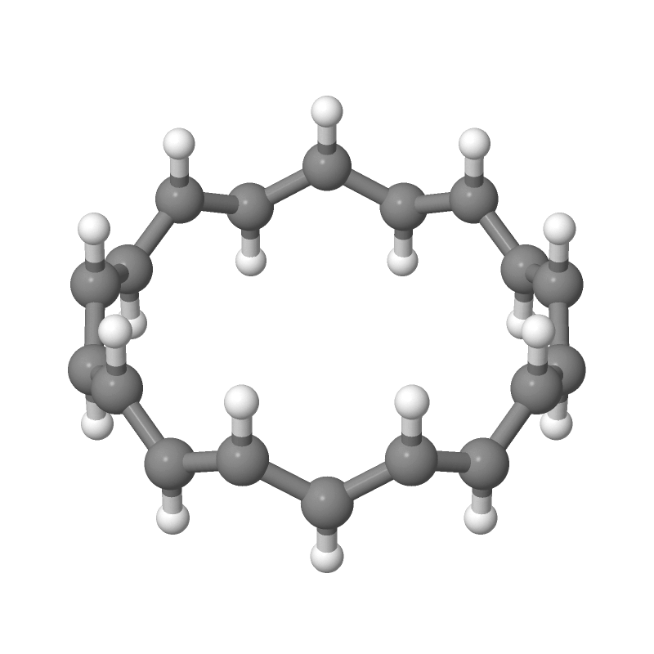
18[annulene]
in nanoring form

Slide 58
7
DFT calculations:
Energies

Slide 59
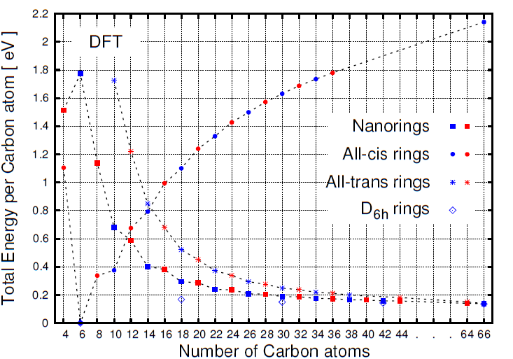

Slide 60
8
DFT calculations:
BLA for nanorings

Slide 61
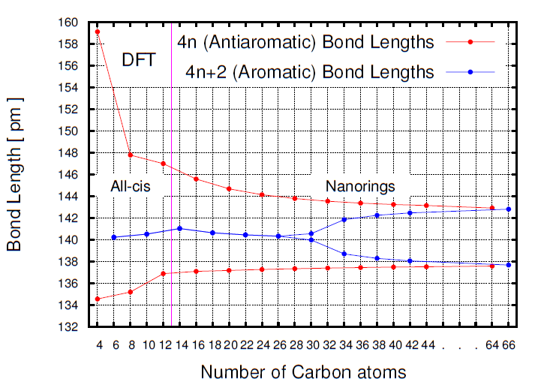
BLA ≈5 pm

Slide 62
SUMMARY
We carried out LHS and DFT calculations for different type of aromatic and antiaromatic annulene molecules.
We demonstrated that the presence of BLA in long conjugated hydrocarbon polymers is independent of the boundary conditions and BLA does in fact appear in hydrocarbon rings as in hydrocarbon chains.
We showed the Jahn—Teller effect in antiaromatic rings and the pseudo Jahn—Teller effect in aromatic rings.
The appearance of BLA for aromatic rings occurs at n_{C}=30 in our DFT calculations.
The BLA for both the antiaromatic and for the aromatic rings converge in the infinite limit to the same value of ≈9 pm (LHS) or ≈5 pm (DFT).

